Slide 1

The Fundamentals of Linux
Caleb Meyer
Notes:
*bored* Hi, I’m Caleb Meyer and this is my talk, the Fundamentals of Linux

Slide 2
Agenda
What is Linux?
Read 400 man pages
Writing your first printer driver
10 flavors of awful C code
Common pitfalls with shell scripting
What to do when Linux crashes
The best way to shave a yak
Linus Torvalds: the man, the myth, the legendary ego
Notes:
First we’re going to look up the dictionary definition of Linux,
then we’ll go through 400 pages of the manual,
how to write your first printer driver, and…

Slide 3
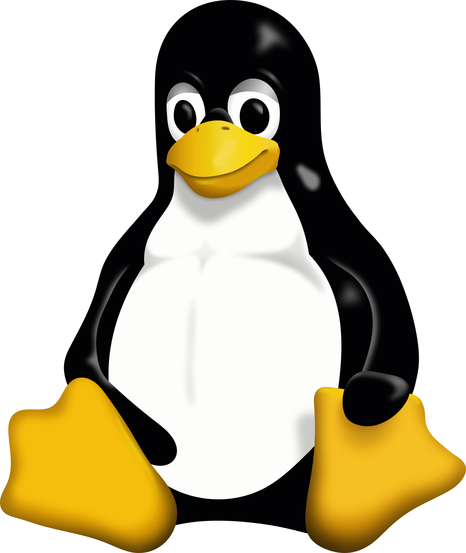
The Fundamentals of Linux
AKA “How to Train
your Penguin”
Notes:
I’m just kidding you all. You should have seen the look on your faces. Linux isn’t boring or scary. It’s actually cool and fun. Stick around, and I’ll tell you why. Then I’ll tell you what. Then I’ll tell you how.

Slide 4

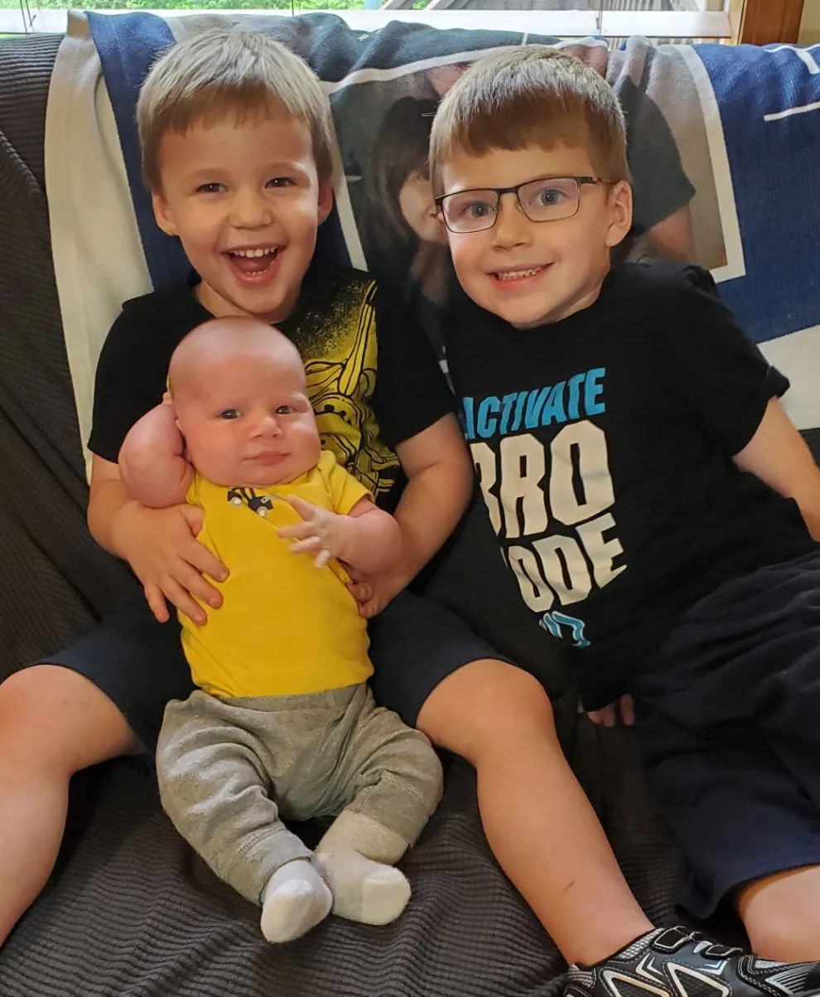
Me
Notes:
But first, why Me? I’m just some random engineer with a wife and a couple kids. I use a mac book pro for work and a windows computer for gaming. Yeah, I deploy my code to Linux boxes, but they’re so many layers of abstraction away that I probably wouldn’t know if you switched them.
However, I’ve been interested in Linux for a couple of years now, and I’ve been doing my research. I’ve got a laptop that runs Linux, a phone that runs Linux, and if all goes well, I’ll soon have a steam deck that runs Linux.

Slide 5
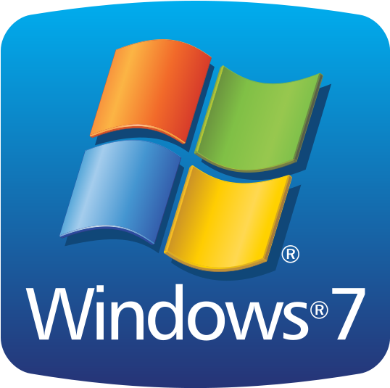
My Journey
Notes:
But before I can tell you about Linux, I need to tell you how I came to it. When I first started at Cerner, I started on an ugly old Lenovo. Windows was the only operating system I’d ever used, except for those weird red hat desktops in the Linux lab at college. I programmed Java using Eclipse, and I worked with some truly awful data transformation and reporting tools. Did I mention I’m in analytics?

Slide 6
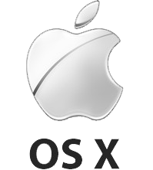
My Journey
Notes:
Then pop health happened, and all the cool kids got macs. Eventually, some ruby programming fell in my lap, and my boss decided I needed a mac. I got a gently used 2012 mac book pro, and let me tell you, what an upgrade. It was faster, had a bigger, brighter, higher resolution screen, more ports, a way better trackpad… it basically outclassed my W520 in every way possible.
Except one… OS ten was different, and not always in good ways. Lose control, take command, they said. Outlook sucked, lync sucked (you all remember lync? *shudder*), even chrome and firefox sucked. There was no good way to maximize things, no easy way to get a calendar popup on the clock (I need my calendar widget, darn it). It was painful to switch. The one saving grace was that the developer tools were miles ahead. Instead of a “power”shell that couldn’t even select text properly, I got to use iTerm, the best terminal on any OS. Instead of eclipse and notepad++, I started using Sublime Text. Instead of windows awful search, I got spotlight, and upgraded it to Alfred. But most importantly, I got used to a keyboard driven workflow.

Slide 7
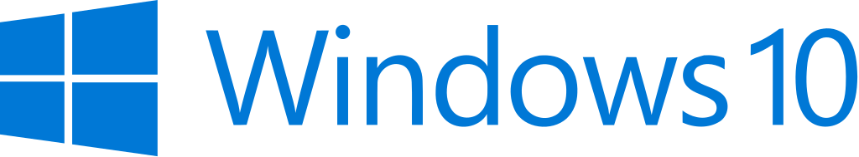
My Journey
Notes:
And then Apple decided that Sir Jony Ive was the best designer ever minted and to never question him EVER. The next macbook had an awful keyboard, this awful touchbar, and took away all the good ports, like USB-A and HDMI. This is around the same time that Dell re-privatized their company and started finally making decent laptops. So I switched back. My dell 5510 had a 4k touchscreen, 2 USB-A ports, 32 GB of RAM, and a discrete graphics card. And the keyboard didn’t suck!
This is also around the time that a lot of our development software became cross platform, so I thought the switch would be easy. But the application I work on, HealtheAnalytics, doesn’t run on windows at all.

Slide 8

My Journey
Notes:
So I added a VM. A popular choice back then was a Linux distribution called Ubuntu. I ran it in VirtualBox, which wasn’t as good as VMware, but the low low cost of free was too hard to pass up. This was my first time using Oracle software in any serious way, but it was also my first real exposure to Linux.
At that time, Ubuntu to me felt like my mac. I did almost everything in a terminal. There was a menu bar at the top and a dock at the side instead of windows’ combined taskbar. And I still used windows for any “serious business” like email and chat. But VMs are incredibly limiting. It’s hard to use them over multiple screens, for example, so I was limited to terminal or text editor or browser or debugger, maybe two if I was willing to squeeze them side by side.

Slide 9

My Journey
Notes:
Fortunately, Satya Nadella took over Microsoft, and started really embracing open source. The Windows Subsystem for Linux, or WSL for short, let you do all those terminal things that you need Linux for, but on the windows side. This fixed a lot of my problems, but it also created a lot more. Because Linux and Windows handled files differently, reading the several thousand that make up our ruby application became very slow. And since this magical translation layer was so new, there were a lot of bugs. Bugs that caused…

Slide 10
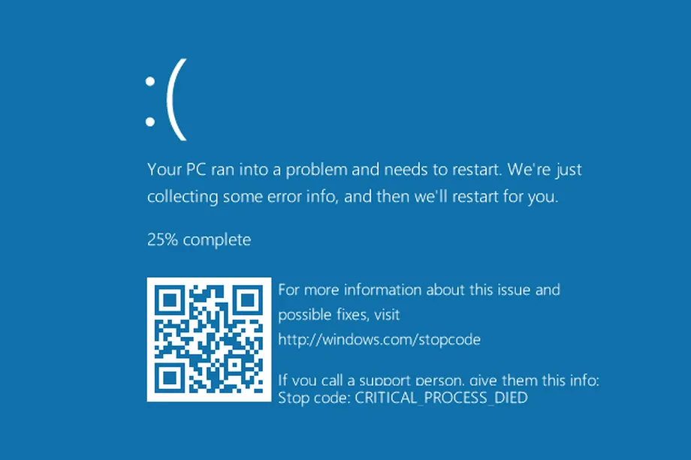
My Journey
Notes:
THE BLUE SCREEN OF DEATH
I was seeing these at least 3 times a week, sometimes several times a day. I also found that our debugging tools just didn’t work on WSL at all.

Slide 11
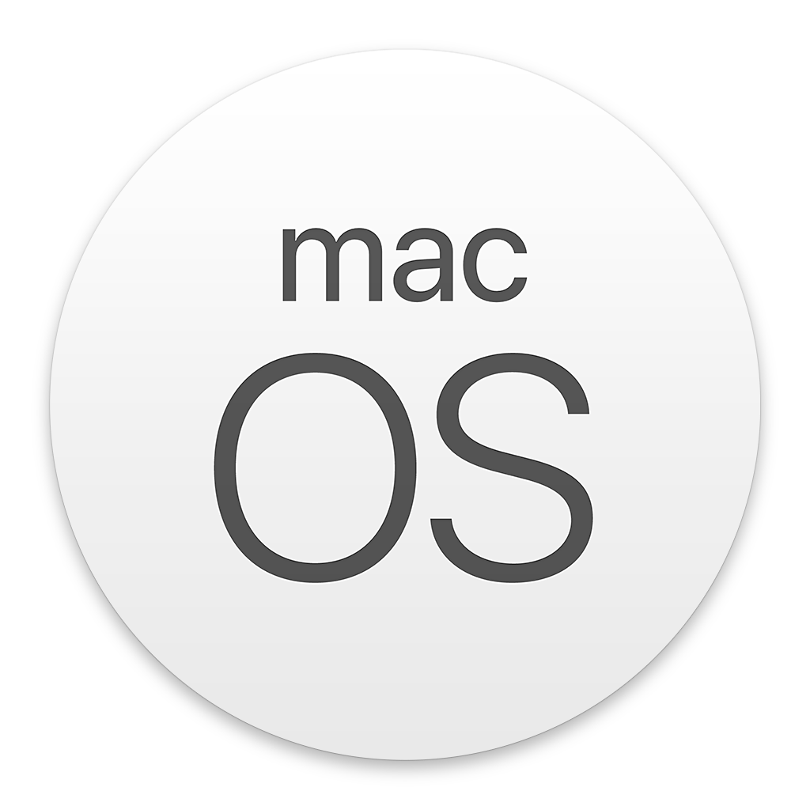
My Journey
Notes:
So I switched back. I bought out that lovely dell hardware and stopped pushing it beyond its limits. And I came back to the mac. I’m still on a mac today, and in August I’m going to upgrade to a mac with a better keyboard and ports. During my dell days, I bought a USB-C dock, so the lack of ports wasn’t as big a deal anymore. And I was finally back to the speed and ease of development that mac brought. I am, after all, a developer first.
Which brings us back to Linux. If macOS is good enough, why care about that weird third operating system that brought windows to its knees?

Slide 12
Linux
Notes:
Probably the most important reason to care about Linux is how big it is. If you’ve used the internet today, I can guarantee you’ve gotten data from a webserver running Linux. The top ten websites on the net use Linux. Over 50% of all websites are hosted on just two webservers, Nginx and Apache, which are both exclusive to Linux. If you have an android phone or a chromebook, it’s running Linux.

Slide 13
Linux?
Notes:
But I’m getting ahead of myself. We’ve gotten this far in the talk, and I haven’t really talked about what Linux is. And for that, we need to go back to college.

Slide 14
Operating Systems
Games
Terminal
File Manager
Calculator
Office Software
Email
Browser
Chat Client
Text Editor
Integrated Development Environment
Resource Manager
Network Protocols
Audio Processing Engine
Shell
Builtins
Accessibility
Features
Crash Handler
Window Manager
Compositor
Network Security
File Permissions
Job Scheduling
Task Monitoring
Device Drivers
User Security
File System
User Input and Output
Printer &
Scanner
Network Adapter
Wireless Adapter
Display
Central Processing Unit
Random
Access
Memory
Hard Disk Drives
Solid State Drives
Peripherals
Notes:
In my Junior Year of college, I had this class, Operating Systems. It was considered a 300-level class because we had to learn some quite hairy C code to pass. Also because Operating Systems are complex beasts. I mean look at all this stuff!

Slide 15
Operating Systems
Software
Operating System
Hardware
Notes:
But the truth is, an operating system is just the code that runs between the software and the hardware. Linux is this purple bit in the middle.

Slide 16
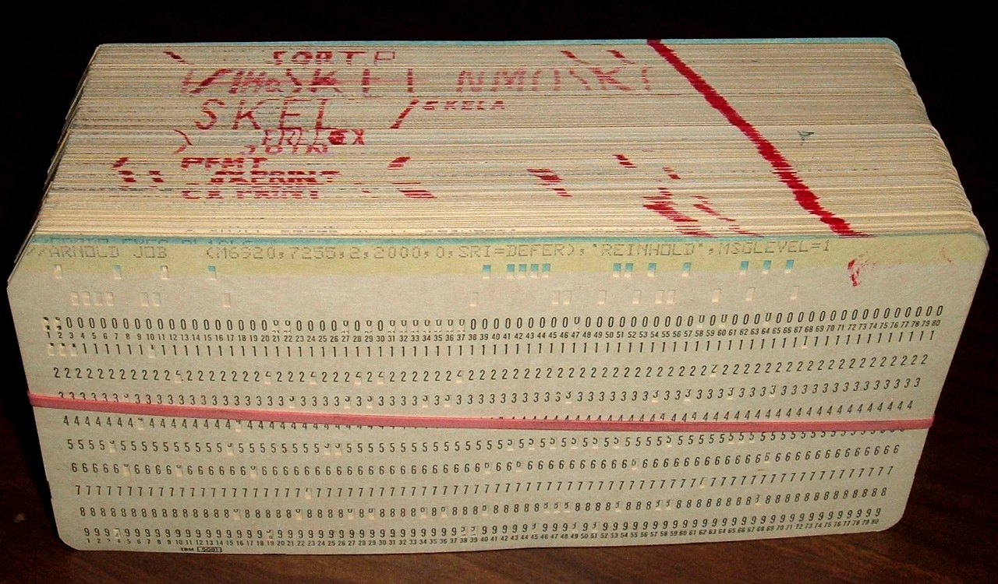
History
Notes:
And how did we get the idea to write software that didn’t run directly on hardware? We tried it that way first. In the beginning of computing, many years before Windows, Operating Systems weren’t really a thing yet. If you wanted to talk to computer hardware, you had to do it by hand, using machine code. Eventually machine code gave way to assembly, and the crazy number of different types of machines collapsed down to a few. The first operating systems were born for single machines.

Slide 17
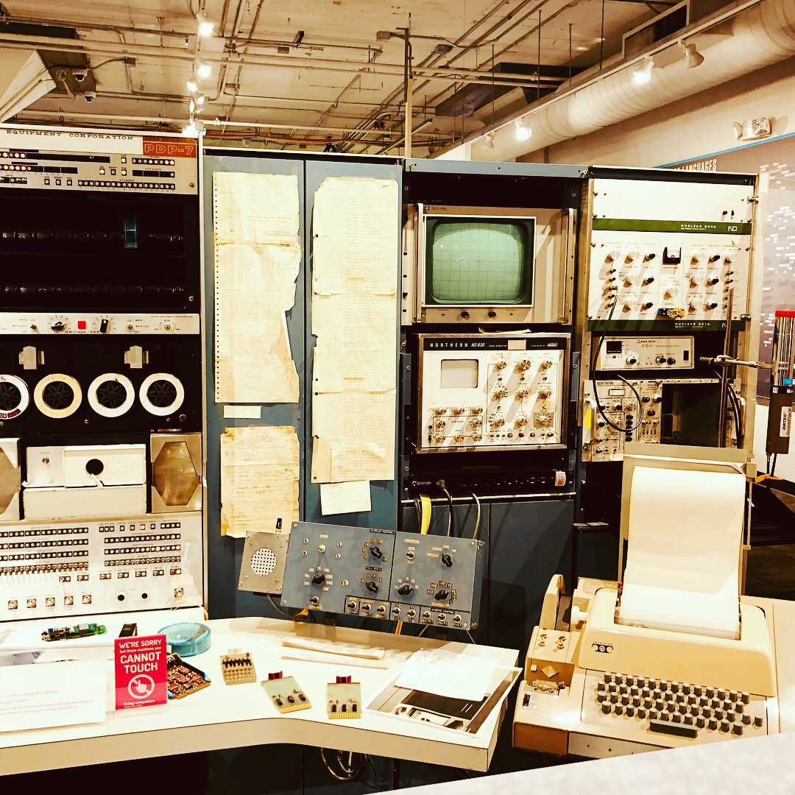
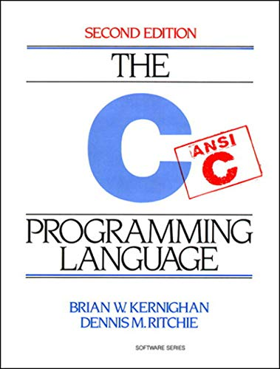
History
A PDP-7
Notes:
UNIX was written at AT&T’s Bell Laboratories starting in 1969 by two guys, Dennis Ritchie and Ken Thompson for the DEC PDP-7 computer. If Ritchie’s name sounds familiar, it’s because he co-created the C programming language. It was born out of the spectacular failure of Multics, the OS the two had used previously.
UNIX didn’t do many things, but it did them well, and became very popular. In 1983, Richard Stallman, a researcher at the Massachusetts Institute of Technology, decided to rewrite UNIX as open source.

Slide 18


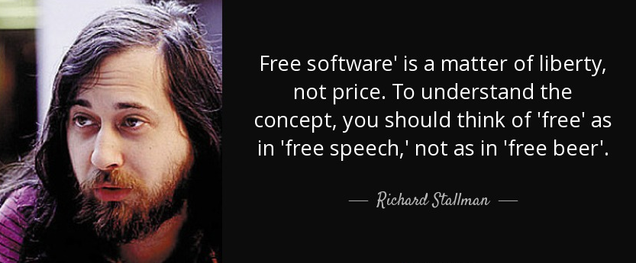
Open Source and The
Notes:
Why rewrite it? See, Richard Stallman was used to being able to fix things around his department. When their printer jammed, he wrote a little script that would notify anyone waiting for a print. When the next printer came in, he was mystified to learn that it didn’t come with the source code, only pre-compiled packages. When he asked a friend over at Xerox to send him the source code, his friend said they weren’t allowed to send it anymore. It was closed source.
This sent him off on a crusade to protect software freedoms, and he created the Free Software Foundation. When the PDP-10 became obsolete, and all the assembly he and others had written for it, Richard started a software project he called GNU, for Gnu’s Not UNIX. GNU was a clean re-implementation of UNIX. More importantly, it was free of cost and guaranteed access to its source code.

Slide 19

The Creation of Linux
Notes:
8 years later, in 1991, Richard Stallman had a compiler, shell, and a bunch of software, but no good operating system kernel to run it on. A Finnish computer science student named Linus Torvalds decided to build a “hobby” operating system as a better version of another OS, Minix.
The new OS, Linux, was the perfect fit to go with the GNU software, which is why you’ll sometimes see it called GNU/Linux or GNU + Linux.

Slide 20

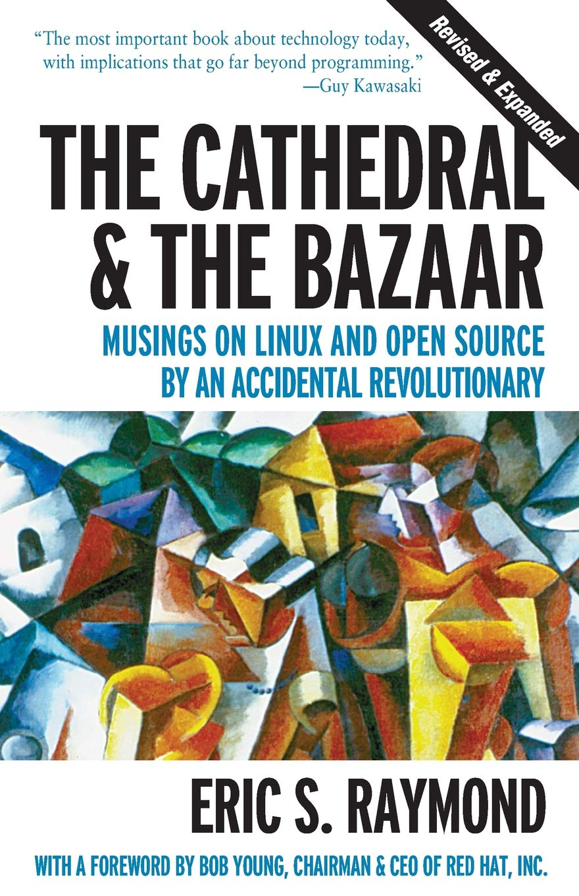

Notes:
There’s a great book called the Cathedral and the Bazaar that talks about why those early versions of Linux succeeded. Multics was an example of a cathedral. It was built by a few and intended to be “perfect.” No one except those few blessed developers got to work on it, and they only released new versions rarely.
Linux on the other hand was open source. Anyone could contribute, and Linus Torvalds welcomed those contributions. It was released frequently, sometimes multiple times a day. And like a Bazaar, it was a bit crazy, but all those people meant that it saw a lot of use. More eyes meant more bugs were found and fixed.

Slide 21

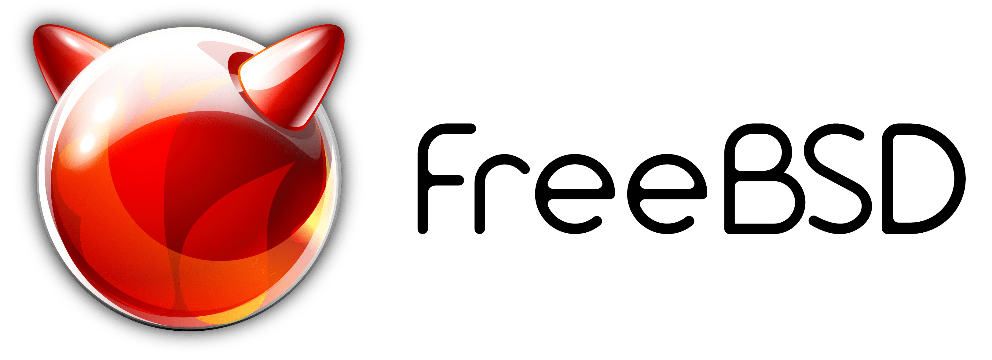
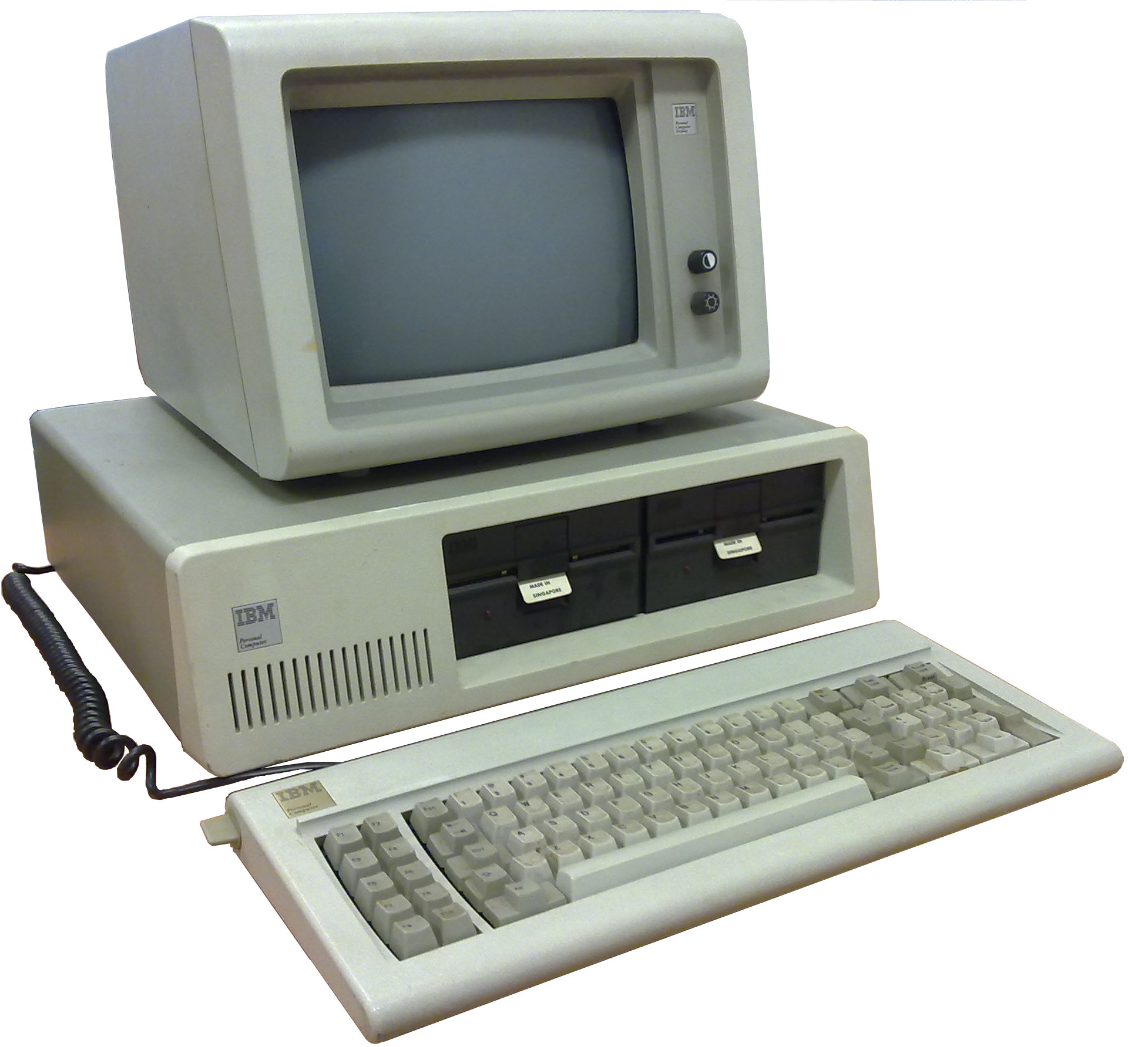

And then came fragmentation
Notes:
So cool, now we have the one OS to rule them all. It’s free of charge, open source, and you can jump in and improve it. Perfect! So why do we have windows and mac today?
Well even before Linux was created, UNIX had competition. Back in 1977, eight years after the first release of UNIX, the University of California at Berkeley forked UNIX into the Berkeley Software Distribution, or BSD. BSD is the ancestor today of macOS, the OS used on PlayStations, and Solaris, the OS made by the same people who originally made Java.
And back in 1981, IBM released the model 5150, more commonly known as the PC. Running on it was an OS from a teeny tiny company called Microsoft. That OS was MS-DOS.

Slide 22
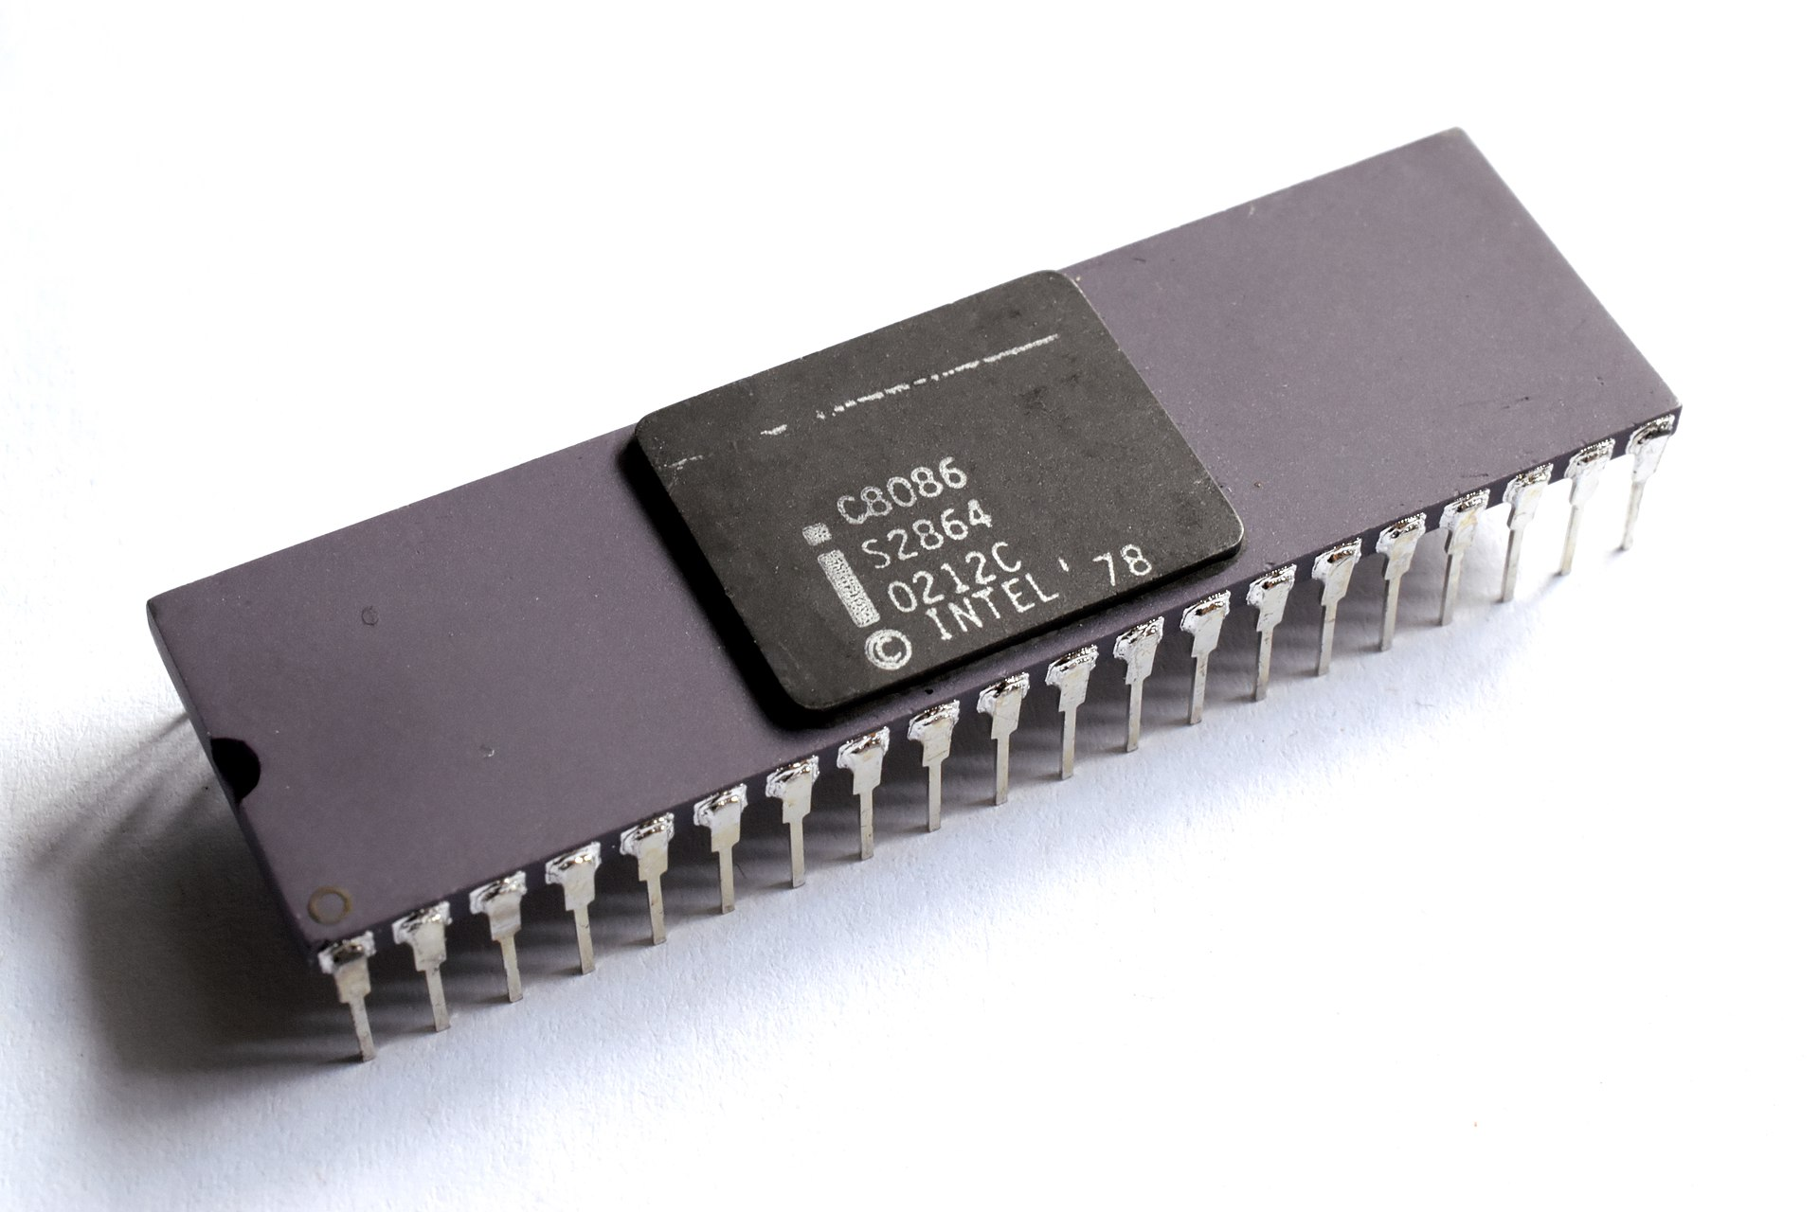
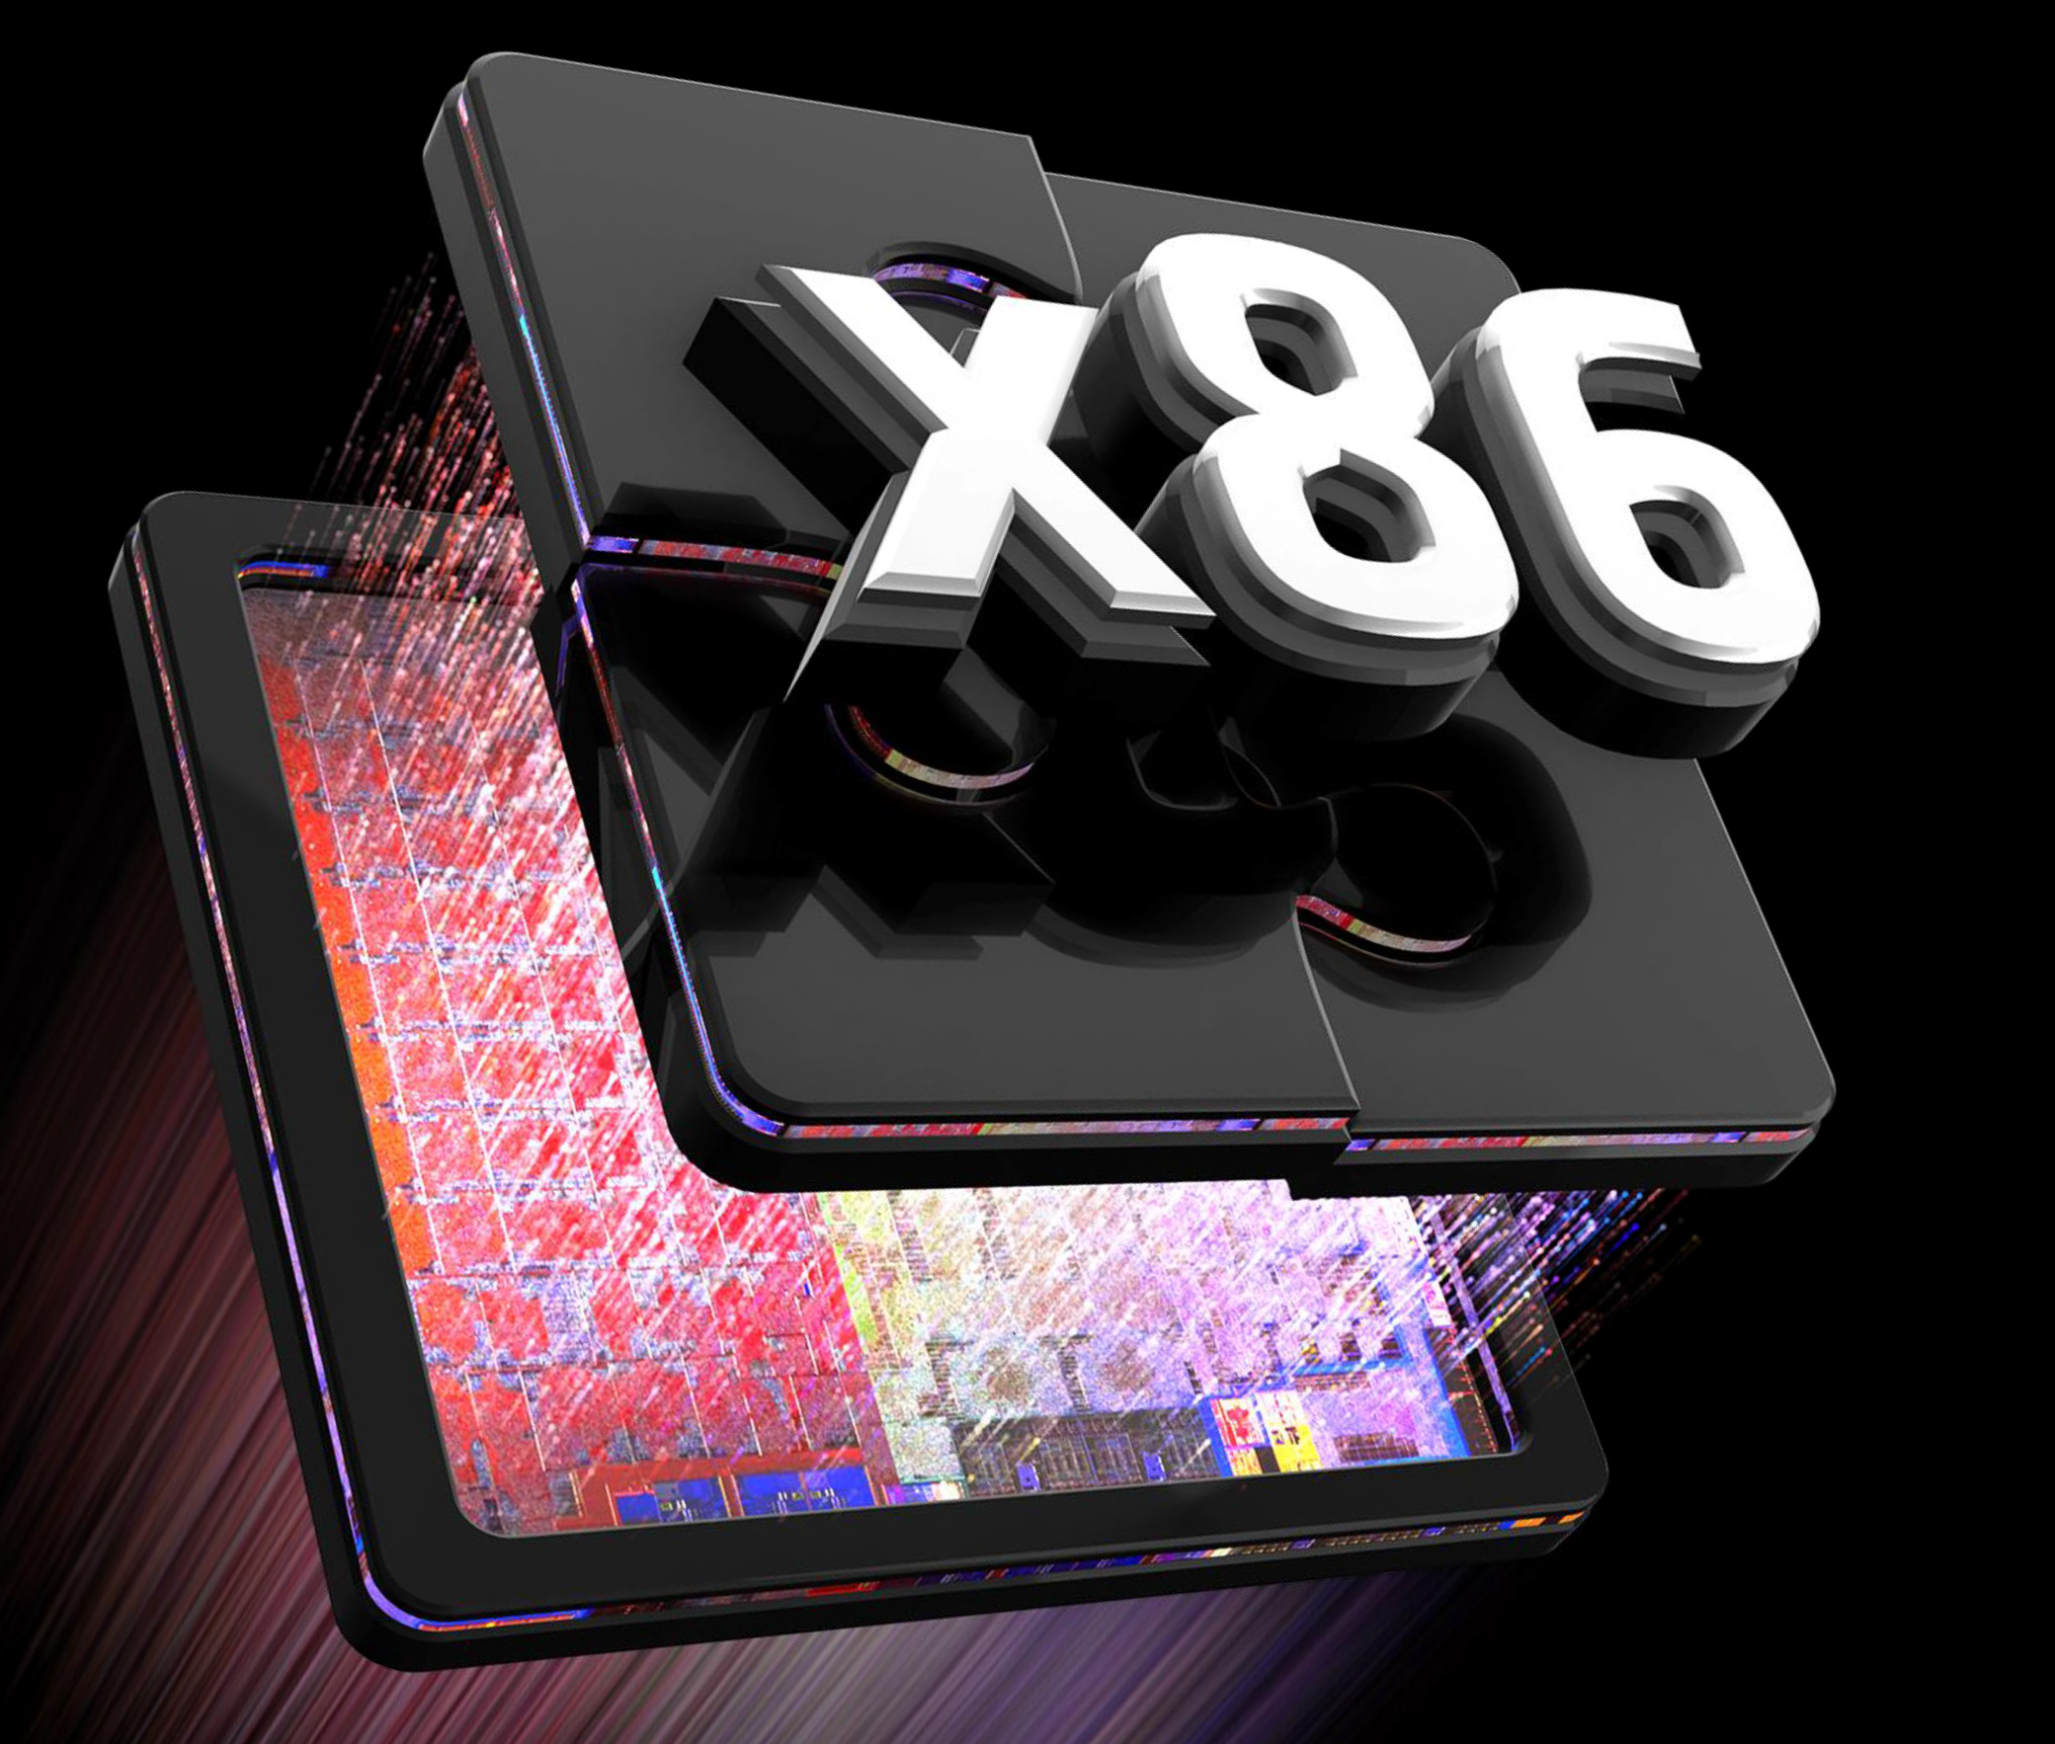
The Competition
An Intel 8086 Processor
This image is ironically from AMD
Notes:
All of this turned into fierce competition for those early Linux versions. Interestingly, Microsoft also had a UNIX they licensed from Bell Labs called Xenix, but the PC dominated the market. The 16-bit Intel 8086 processor was so popular that we still use a variant of its CPU architecture today, called x86.

Slide 23
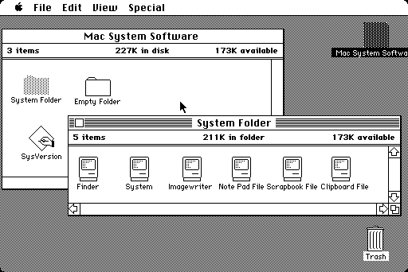
The Competition
Notes:
But Microsoft wasn’t the only tiny company to get in on early computing. Apple released their System 1, the very first Macintosh operating system, back in 1984. You might recognize some of its contributions, like graphical user interfaces that could be controlled by a mouse and had menus like File and Edit. Apple even back then was huge on marketing and bought a lot of ads for their computers.

Slide 24
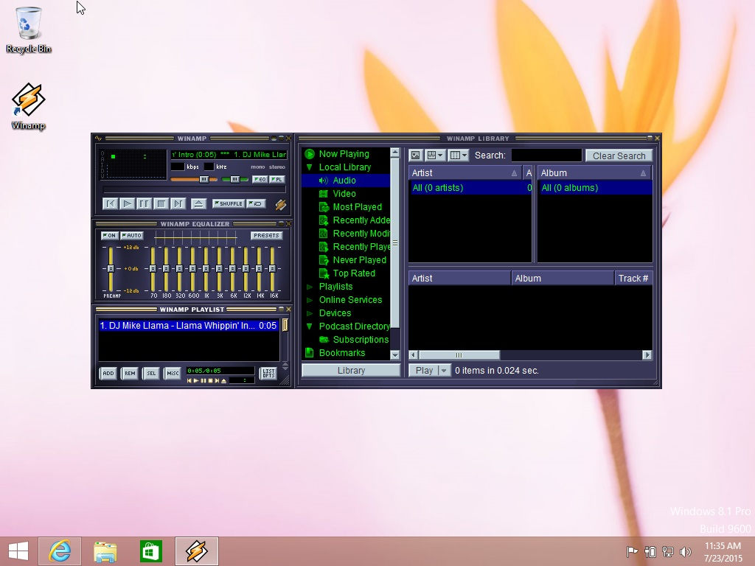
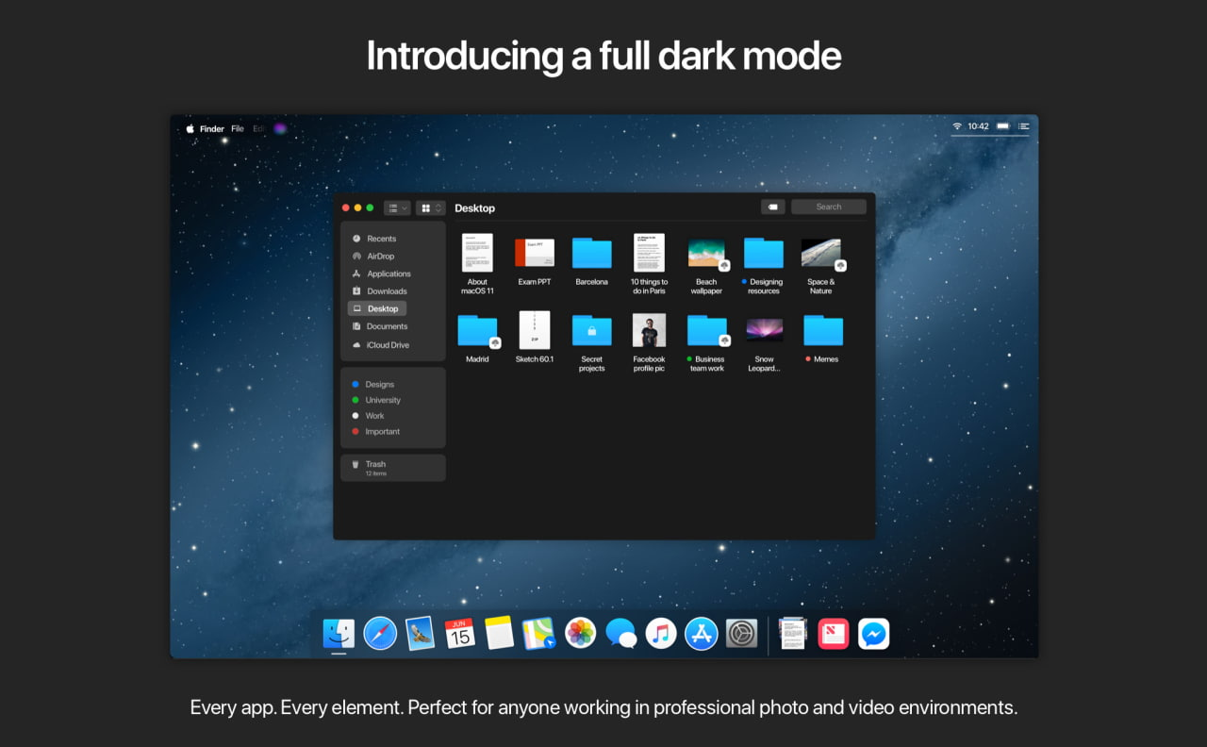
The Competition
Anyone else miss crossfade in Winamp?
Notes:
Microsoft and Apple had clear visions of where they wanted their computing muscle to go, and it really shows through in their operating systems. Windows is famously compatible, to the point that you can reasonably expect to run software from windows 3.1 or 95 in windows 11 and it will work. macOS is famously designer, and you can expect everything to be colorful and high resolution, with those same menu bars in every app.

Slide 25
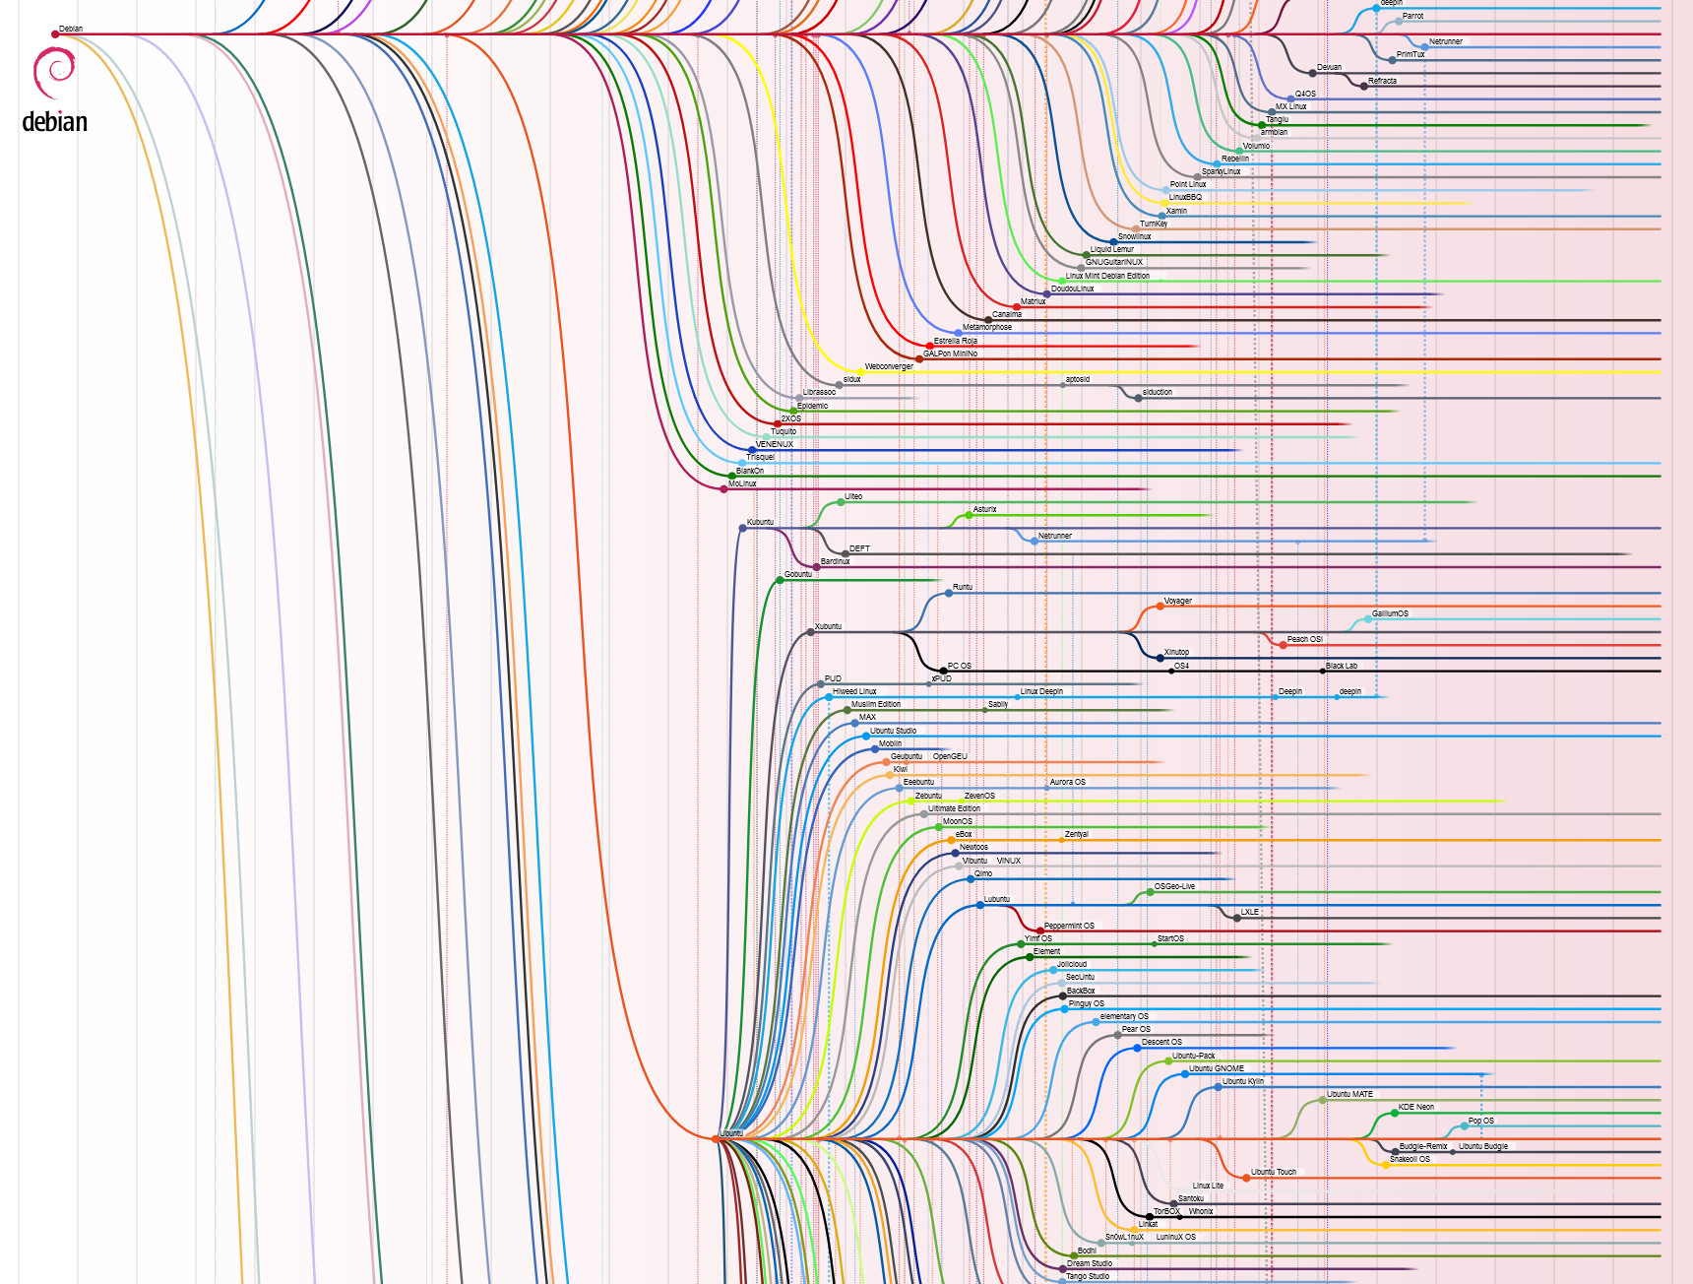
Linux Fragmentation
This is a tiny piece, maybe 10% of this full chart.
Notes:
Linux, meanwhile, fragmented in a huge way. When the draw of your system is that anyone can create anything they want on top of it, people create things. Lots of things. Different things. Things that don’t agree with each other. Many people cite this as the greatest weakness of Linux. It’s so fragmented that we don’t get everyone’s efforts moving in the same direction. Even Linus Torvalds himself blames this as the reason we don’t see more usage of Linux on desktops. But in reality, this is Linux’s greatest strength. It really does have something for everyone.

Slide 26

The Birth of the Distribution
Notes:
And that something is often called a distribution. A distribution of Linux is the whole package. It will have the operating system, of course, but also an installation wizard, a package manager, a default look and feel, and some default applications.
In 1993, Ian Murdock created Debian, one of the earliest distributions of Linux that’s still in use. The Debian project was very much in the spirit of Linux and GNU, the first distribution that was open for every developer and user to contribute their work. Ubuntu is based on Debian. Debian is a very stable distribution. They make changes rarely and only after lots of testing.

Slide 27

The Birth of the Distribution
Notes:
Also in 93, the company Red Hat was founded, and in 1994 they created a commercial Linux distribution called Red Hat Linux. That was later rebranded as Red Hat Enterprise Linux, the very first distribution I ever used. Today, Red Hat makes Fedora, a distribution which Linus Torvalds and I both use. Fedora releases new major versions twice a year but does a great job keeping its software up to date in between big releases.

Slide 28

The Birth of the Distribution
Notes:
Finally, way later in 2002, Judd Vinet created a distribution called Arch Linux. Arch is the last of the three biggest distributions in heavy use for desktop Linux today. It follows a rolling release cycle, meaning there aren’t hard cutoff versions. Every package is updated when its updates are ready, instead of waiting for a big release. This means Arch tends to have the latest, bleeding edge software.
There are many other distributions, including the ones used in chromebooks and android phones, but these three are at the heart of nearly every good option for desktop Linux.

Slide 29
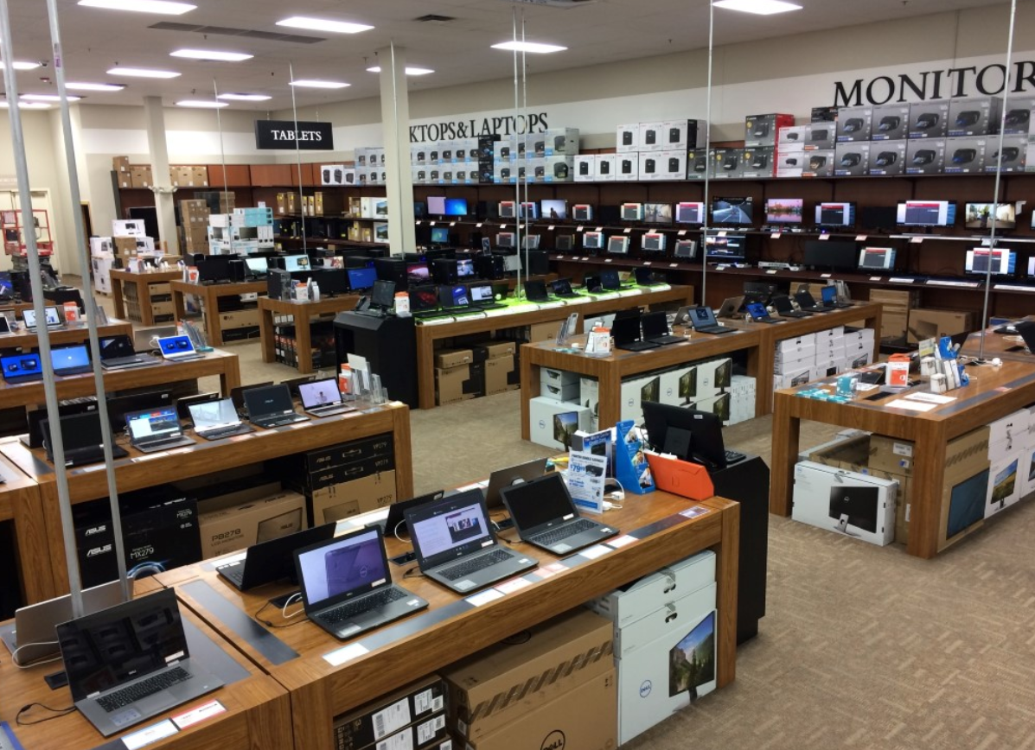
Why?
Notes:
And desktop Linux brings me to the “Why?” part of all this. Why should we care about Linux? If you go to microcenter and buy a computer, it’ll either have a fancy white box with an apple logo on it or it’ll be running windows. Either way, you get a mature, stable, tested operating system that has worked well for millions of people. And if you’re paying that apple tax, you already have a unix descendant as your OS.

Slide 30
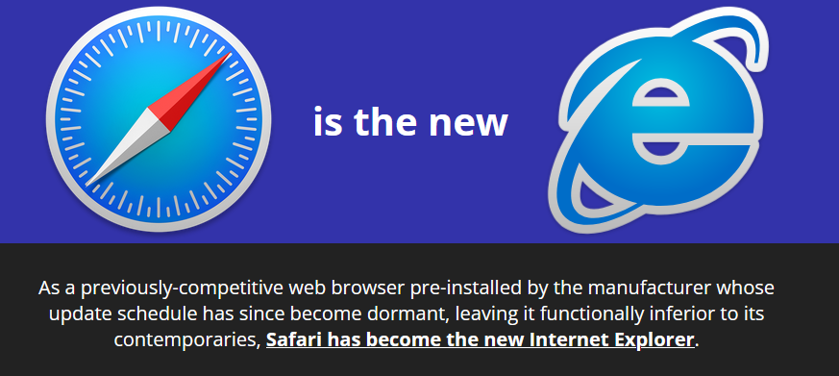
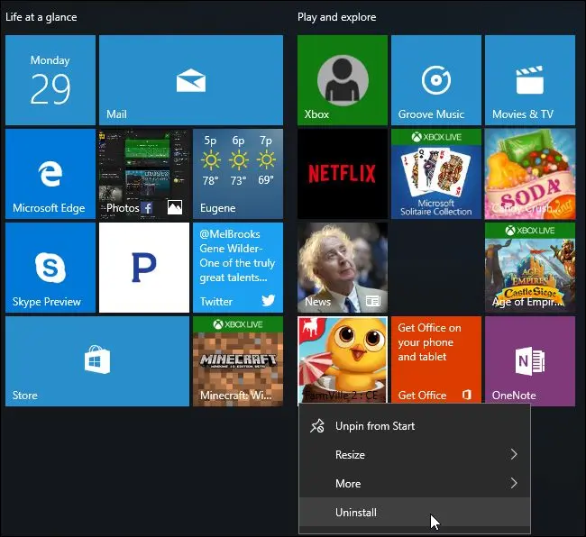
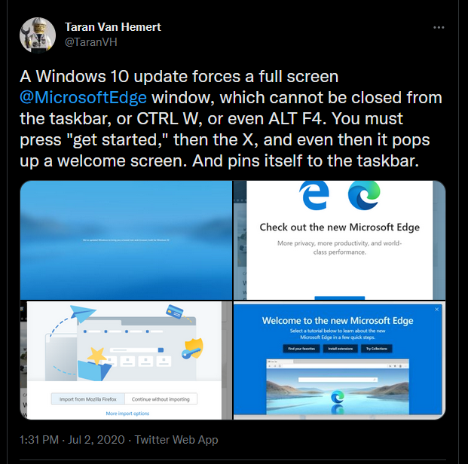
Why?
Notes:
But you don’t have to look very hard to find a lot of unhappiness with windows and mac. People will tell you Windows is full of viruses, and the OS itself is basically spyware. If you open up your start menu on windows 11, you get ads. On windows 10, you get candy crush, a horribly predatory mobile game. The device makers like Lenovo, Dell, and HP have all gotten in trouble for packaging garbage into your windows install. And how many times have you had Edge pushed on you? On the Apple side of the fence, the finder is next to useless, Safari lags behind other browsers, and Apple themselves kneecap their app ecosystem every few years. And macOS still doesn’t know how to run two monitors off of a single port.
If you’ve ever looked at desktop Linux in the past, it would be easy to accuse it of being ugly, slow, and incompatible. And I’m with you there! When I was running that Ubuntu VM for work, it was all those things.

Slide 31
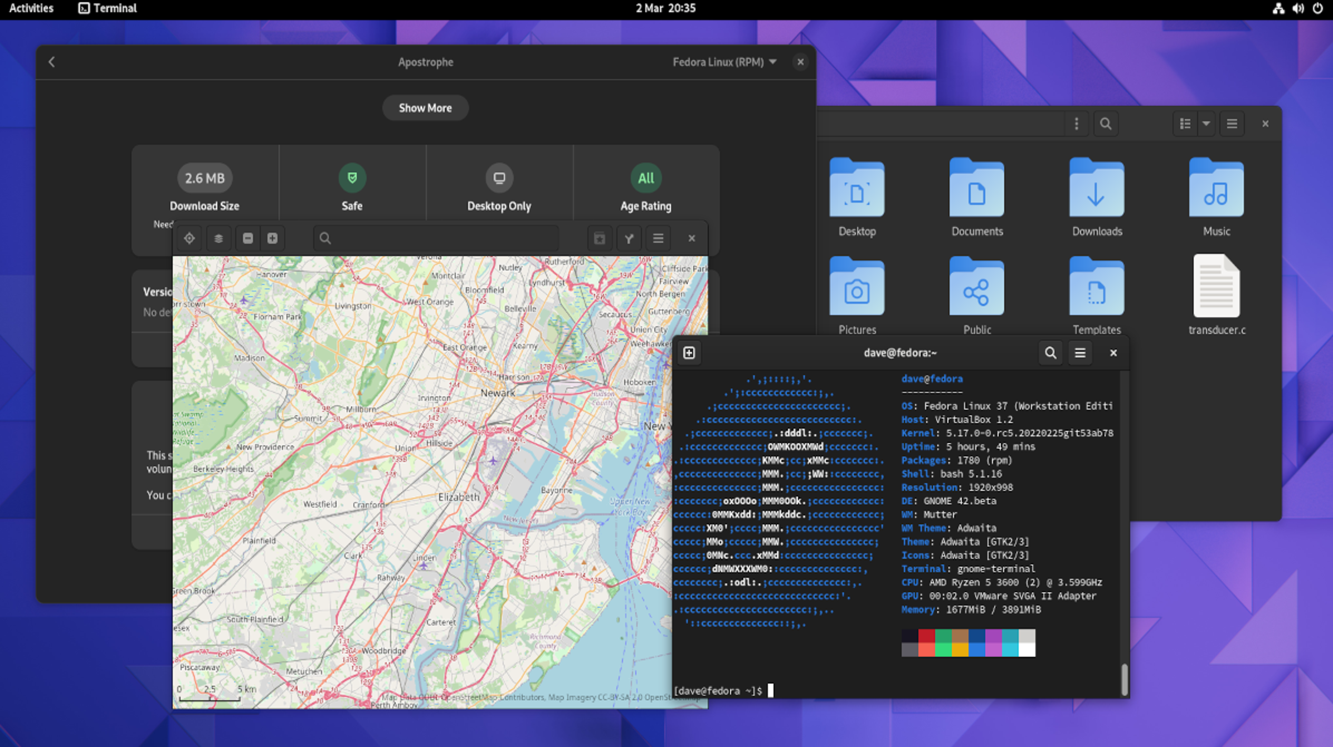
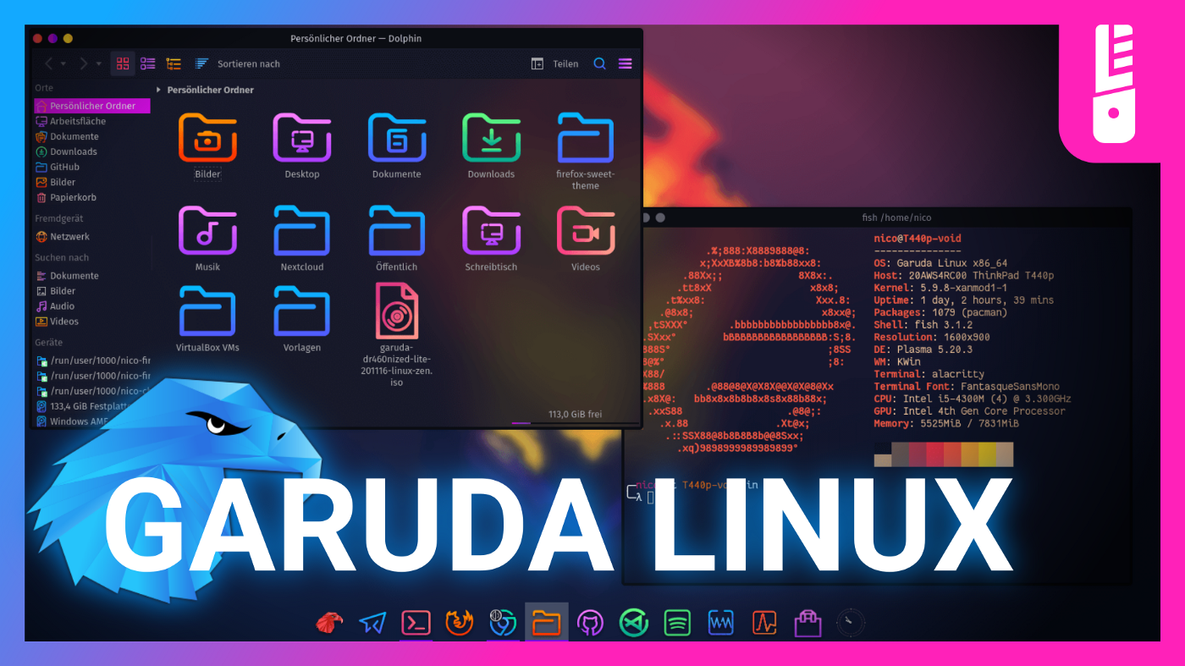
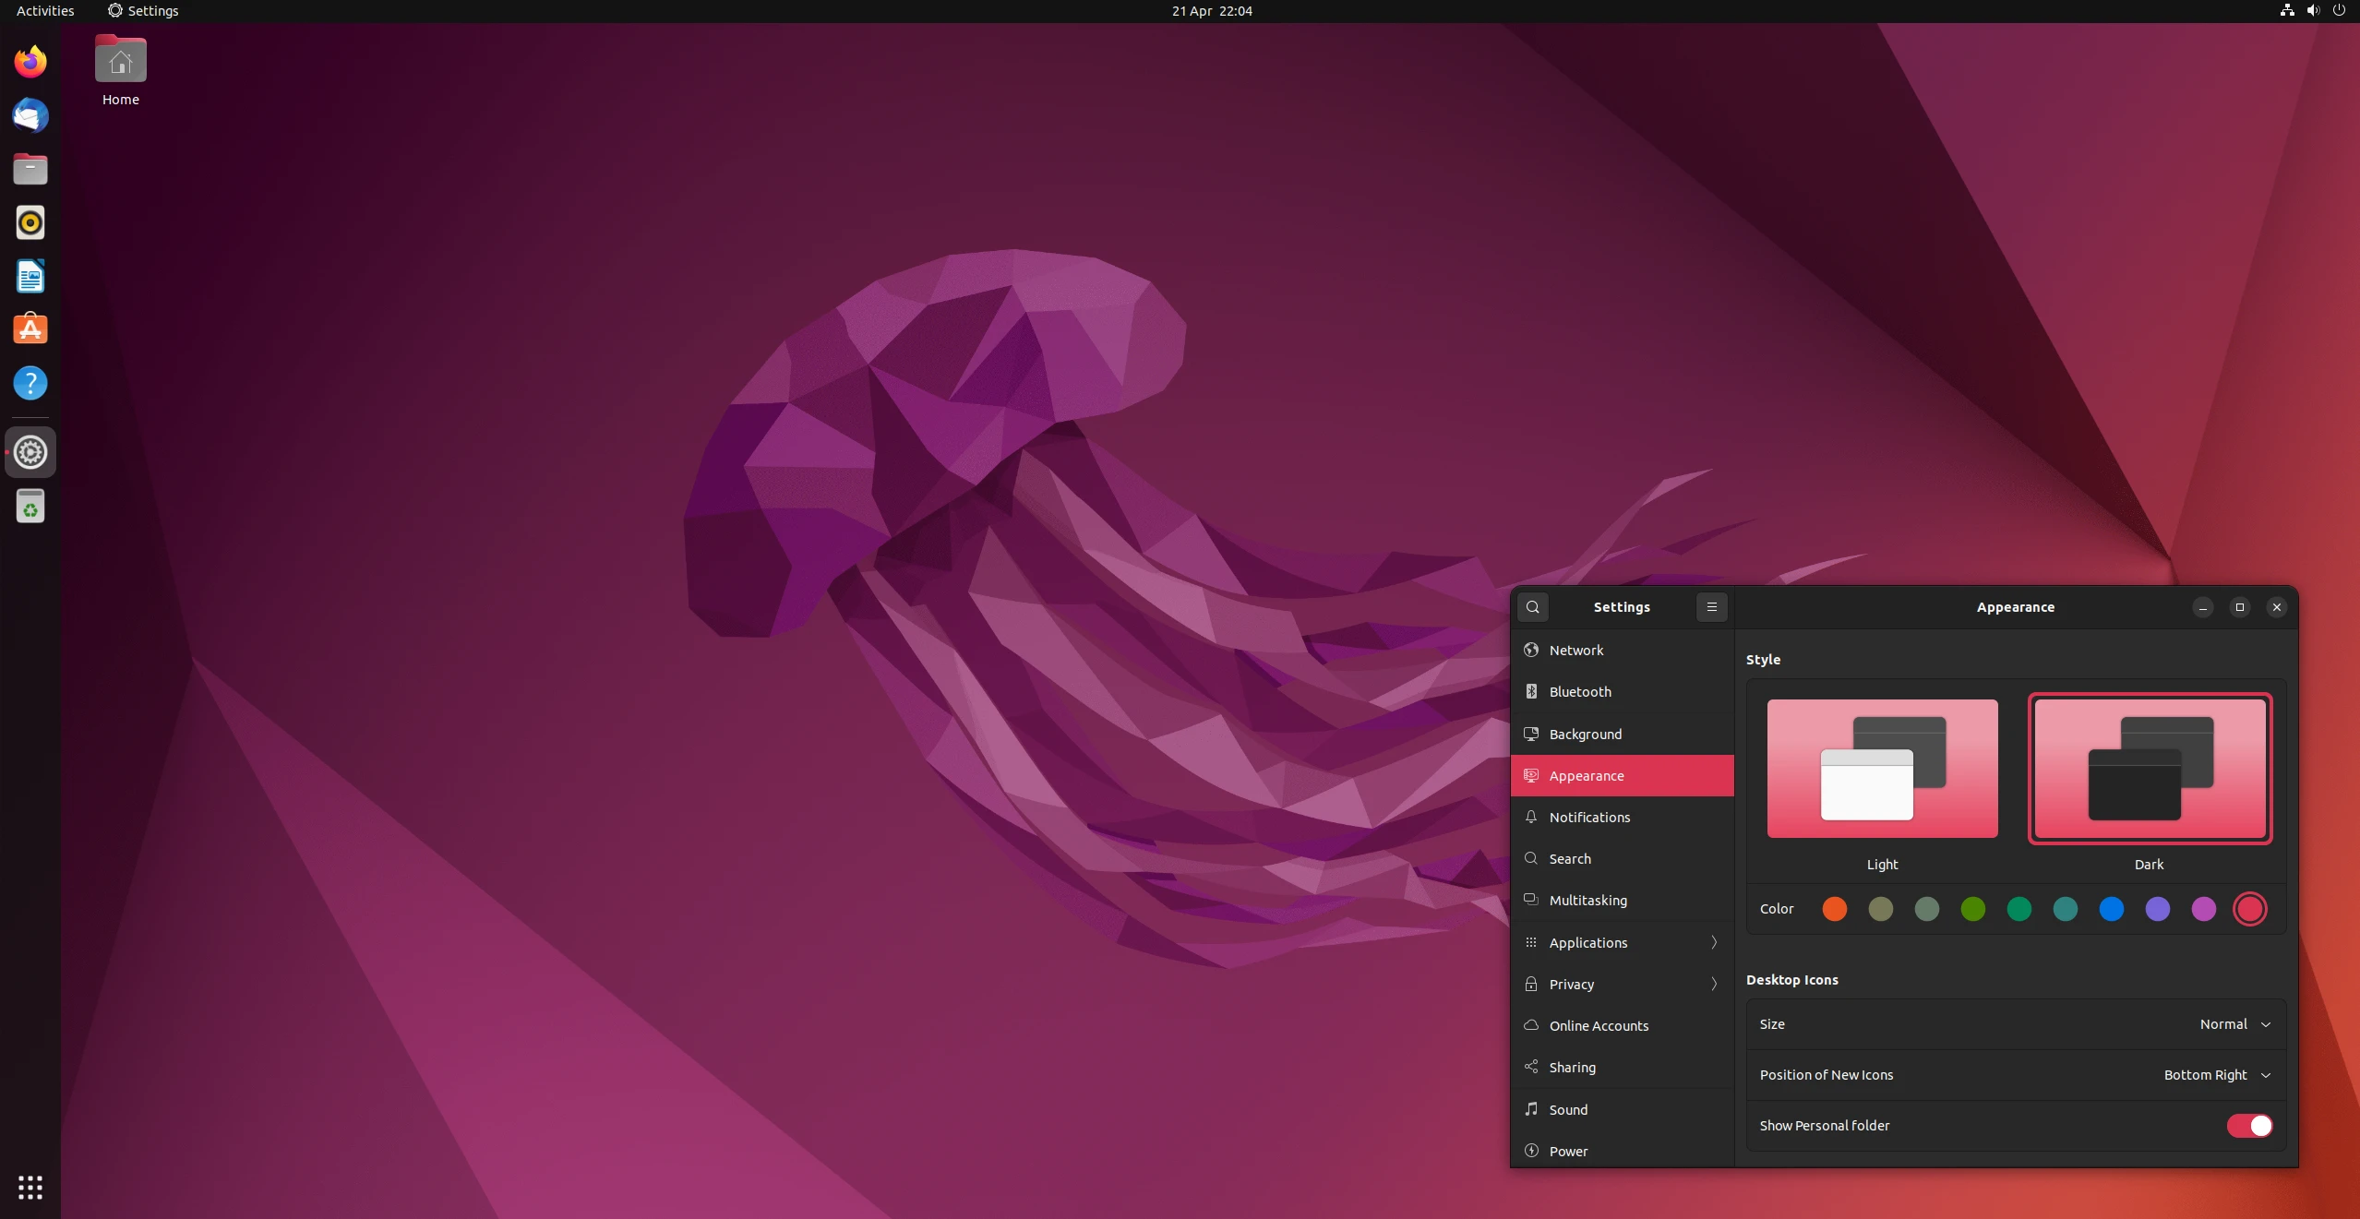
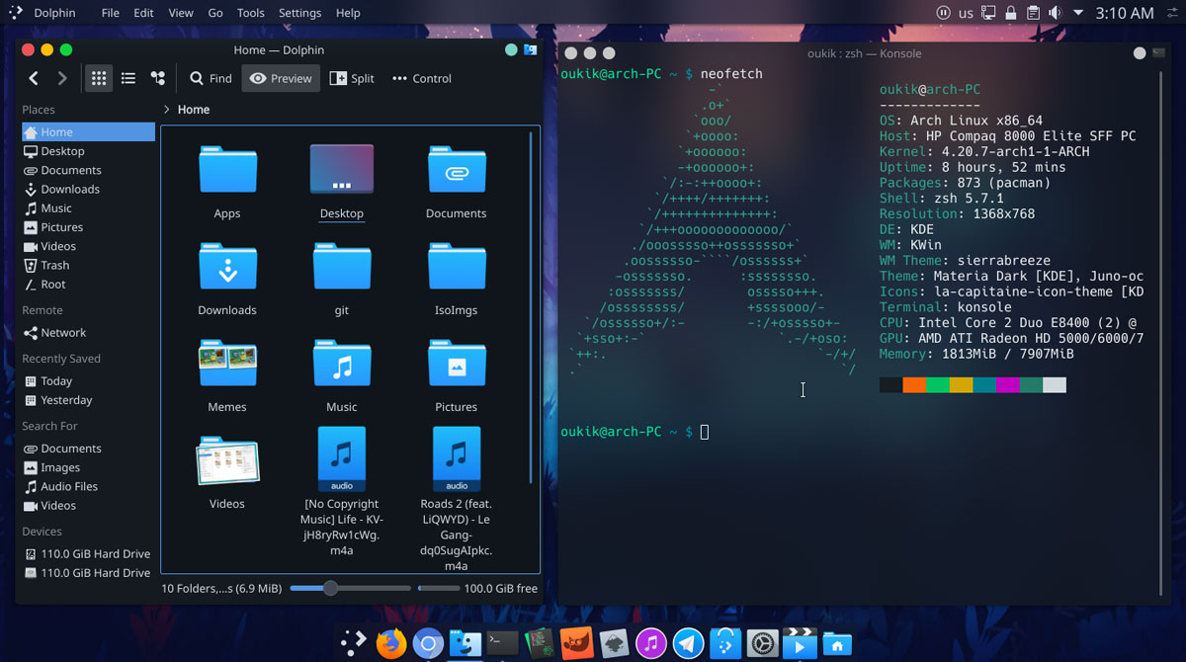
The Year of the Linux Desktop
Notes:
But have another look at Linux today. It’s more customizable, more user friendly, more compatible, and more beautiful than ever. And if you have a problem with it, you don’t have to whine to Microsoft or Apple to fix it. Just roll up your sleeves.
Linux has always been free as in speech and free as in beer. It’s always been incredibly stable, running years without a reboot if necessary. And it’s always had the device drivers built in. Remember that the guy who built GNU did it because of a printer, and you won’t be surprised to hear Linux supports your printer without the CD. Your fancy mouse and keyboard too.

Slide 32
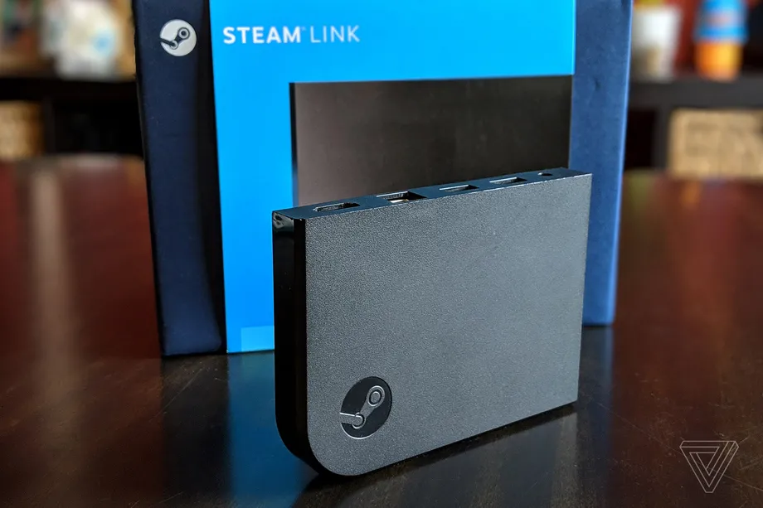
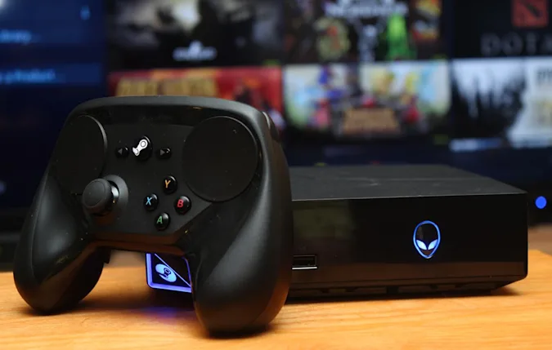
Year of the Linux Desktop Handheld
Notes:
And Valve, the gaming company who makes Steam, realized a bunch of years ago that if Microsoft closed up their operating system to only use the Microsoft store, Steam would die. So they made a gaming focused distribution of Debian and called in help from Alienware and others to make Linux consoles called Steam Machines. Steam machines and the steam controller flopped. Then so did the Steam Link, a streaming box that let you play games from your PC on your living room TV.

Slide 33
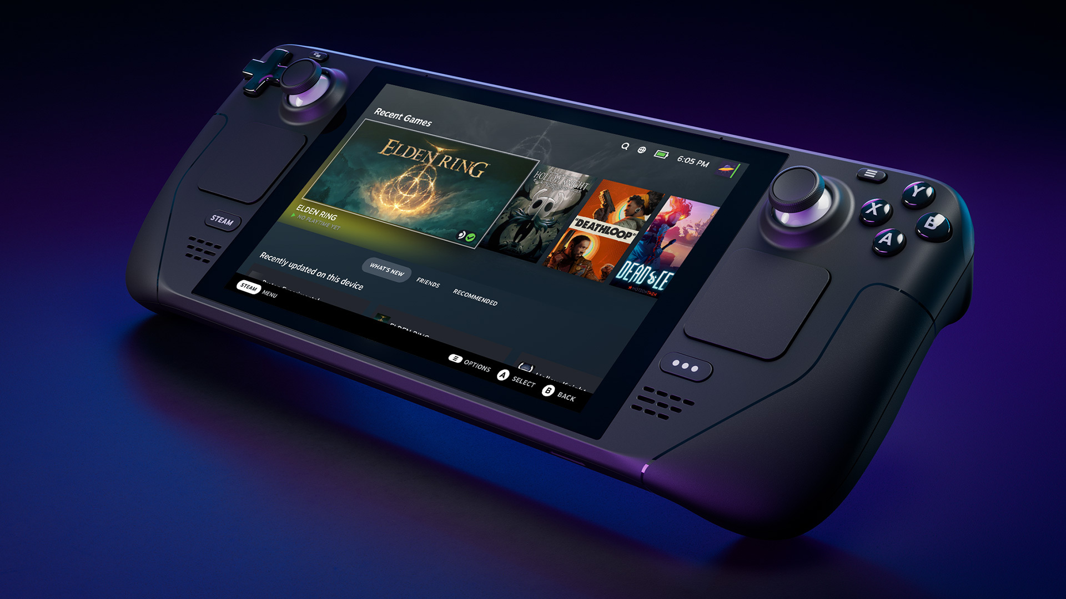

Year of the Linux Desktop Handheld
Notes:
But Valve never gave up on their dream of being free of Windows. So they poured money and developers into a fork of Wine, a translation layer that lets you run windows on Linux. It’s sort of the opposite of WSL. Today you can run most windows software directly on Linux using Wine. And with that software support, Valve is making the Steam Deck, a handheld gaming device that runs Valve’s own Steam OS, now built on Arch for faster updates.

Slide 34
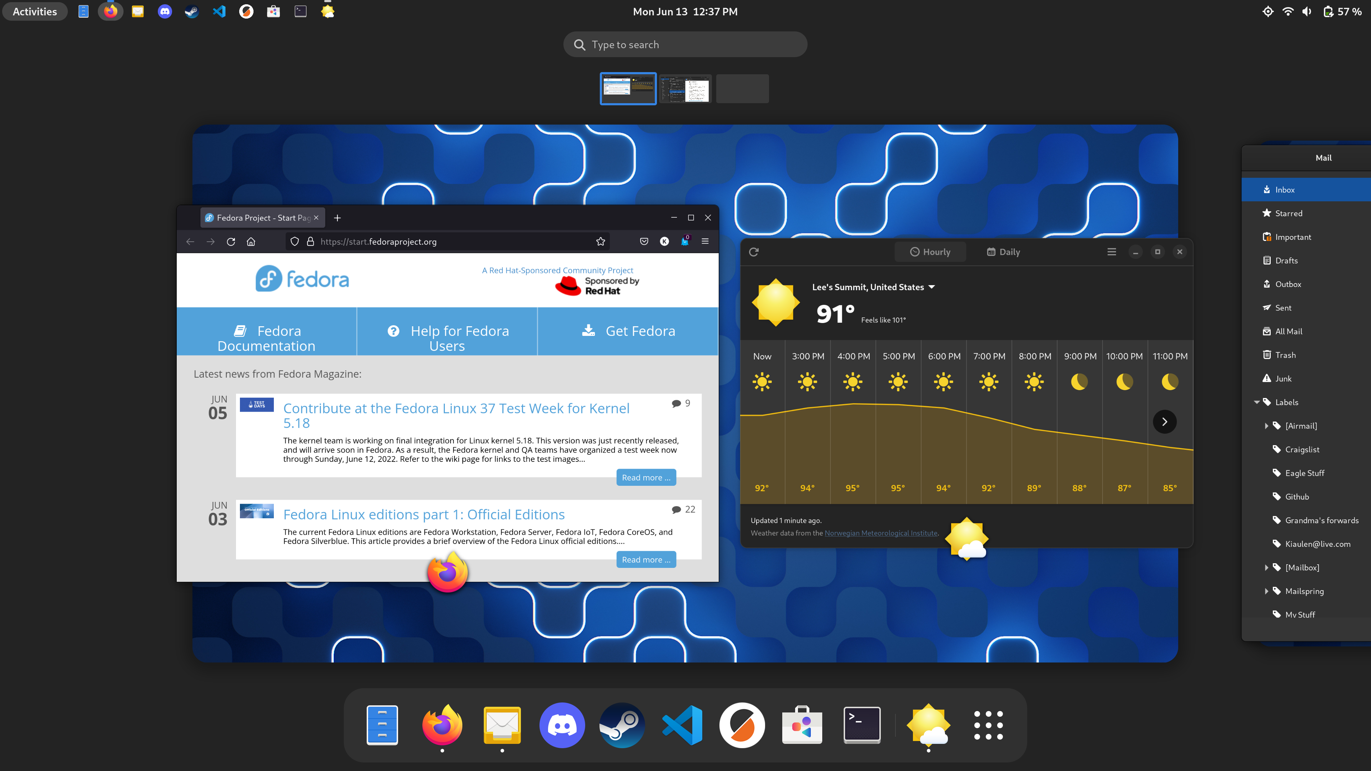
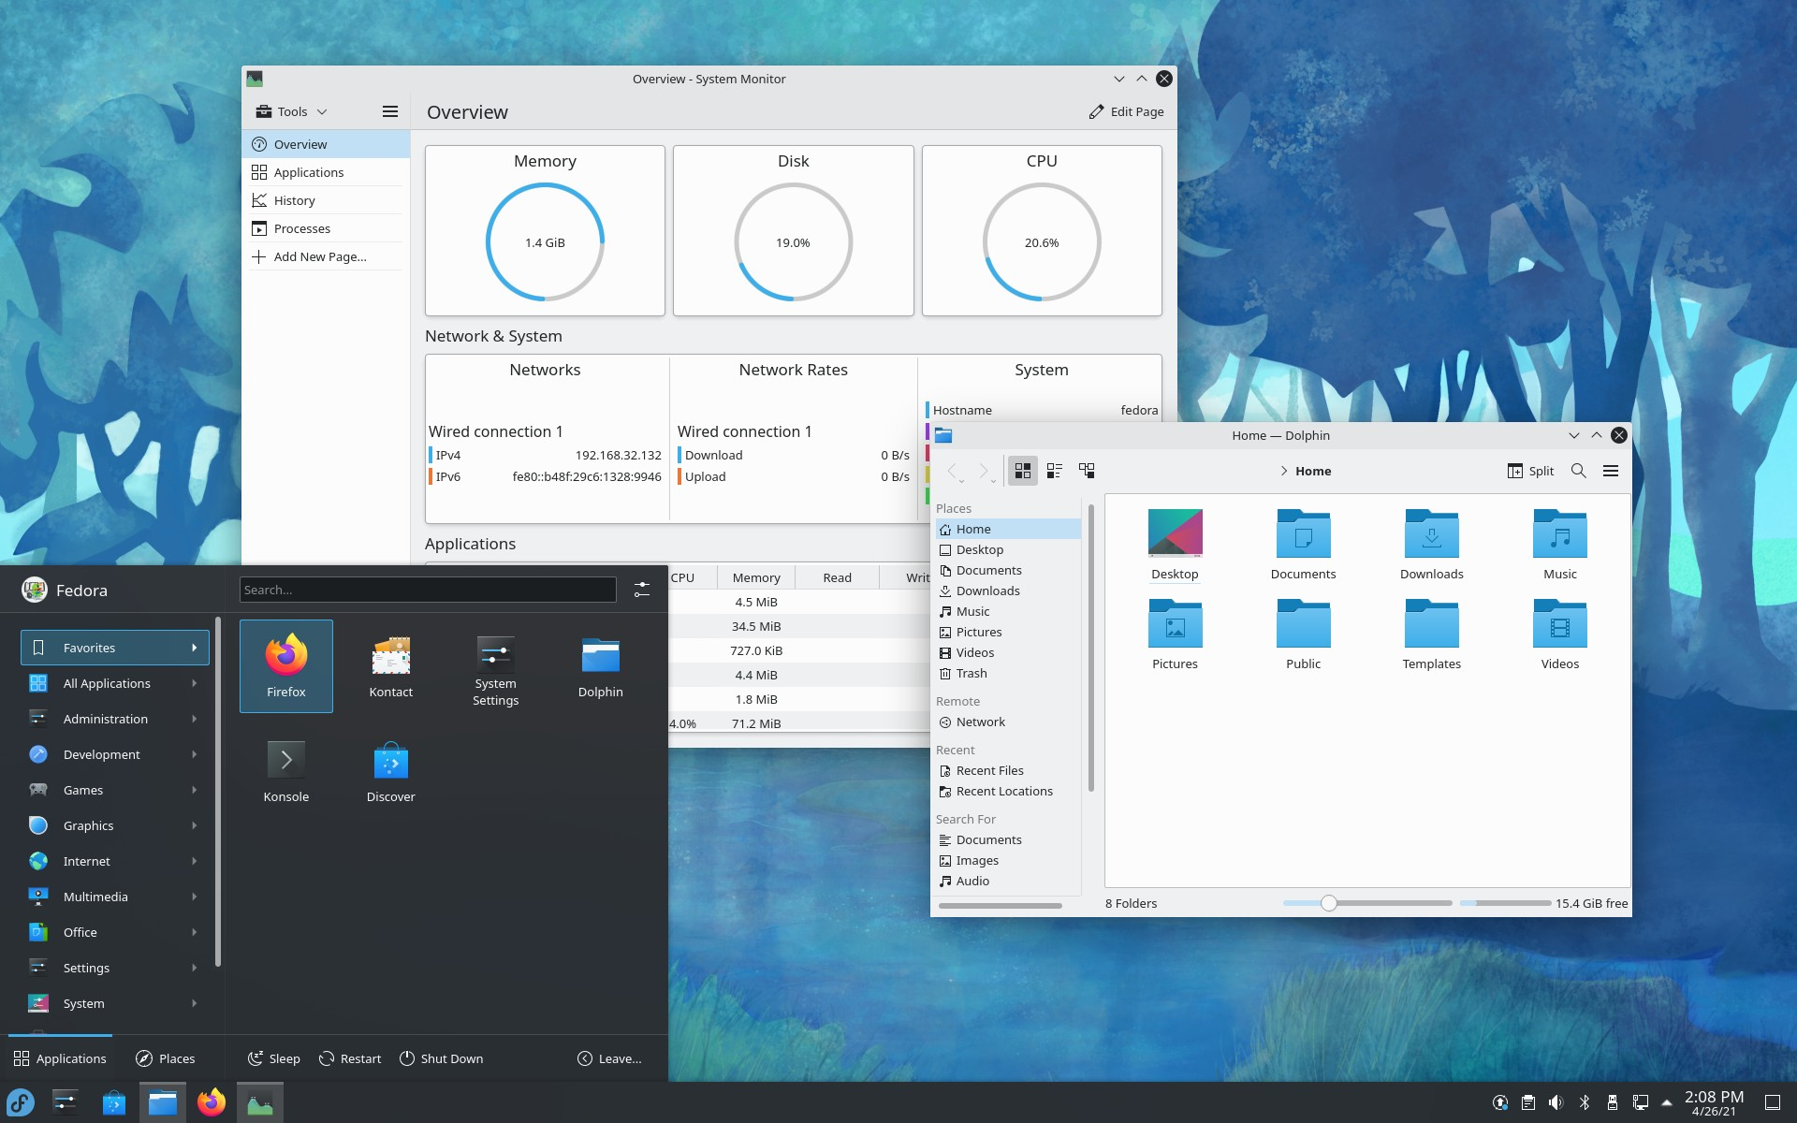
Getting Started With Linux
getfedora.org
Gnome Desktop Environment
(default)
KDE Plasma Desktop Environment
Notes:
Okay, Caleb, you’ve convinced me. I want to try out Linux for myself and see if it’s right for me and my old laptop or desktop, since Cerner doesn’t allow me to replace windows or macOS on my work computer. How do I get started?
First you need to choose a distribution. There are literally hundreds to choose from, but my recommendation is to start with Fedora. Debian based distros like Ubuntu tend to be a bit behind on updates in favor of stability. Arch based distros like Manjaro tend to live too close to the bleeding edge and break frequently.
Fedora is a nice middle ground, with frequent but well tested updates. Once you’ve picked a distribution, you need to pick a desktop environment. If you like the look and feel of windows, I’d recommend the KDE Plasma spin of Fedora. If you like the look and feel of macOS, or want something different but better, go with the default Fedora workstation, which uses the gnome desktop environment.

Slide 35
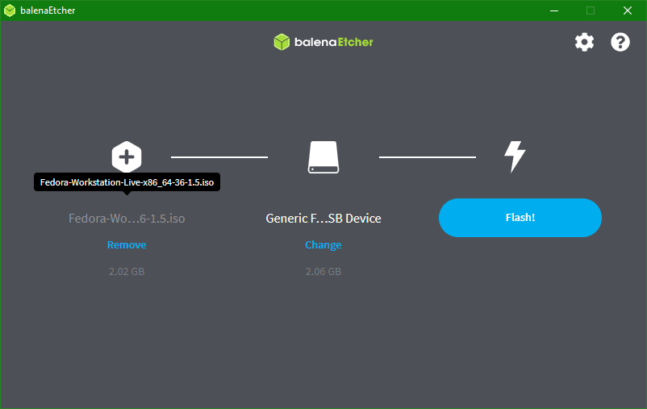
Installing
Notes:
Once you’ve picked a distribution, you’ll get a .ISO file. A .iso file is basically the entire contents of a CD or DVD, all zipped up. If you don’t want to accidentally mess anything up, you can try out your new Linux in a virtual machine. If you are coming from a windows machine, VMWare Player is free and works great. If you’re coming from a mac, you’ll have to use VirtualBox. If you want to install Linux either instead of your current OS or alongside it, you’ll need to put your ISO on a flash drive using a free program called Balena Etcher.
Once you have your ISO on a flash drive or loaded into your VM host of choice, you need to boot the system to Linux. This part can be very simple, or it can get complicated, but I’ll include links to helpful guides at the end of this talk.
If it all ends up being too much, you can use distrotest.net to preview a distribution in one click from a browser.

Slide 36
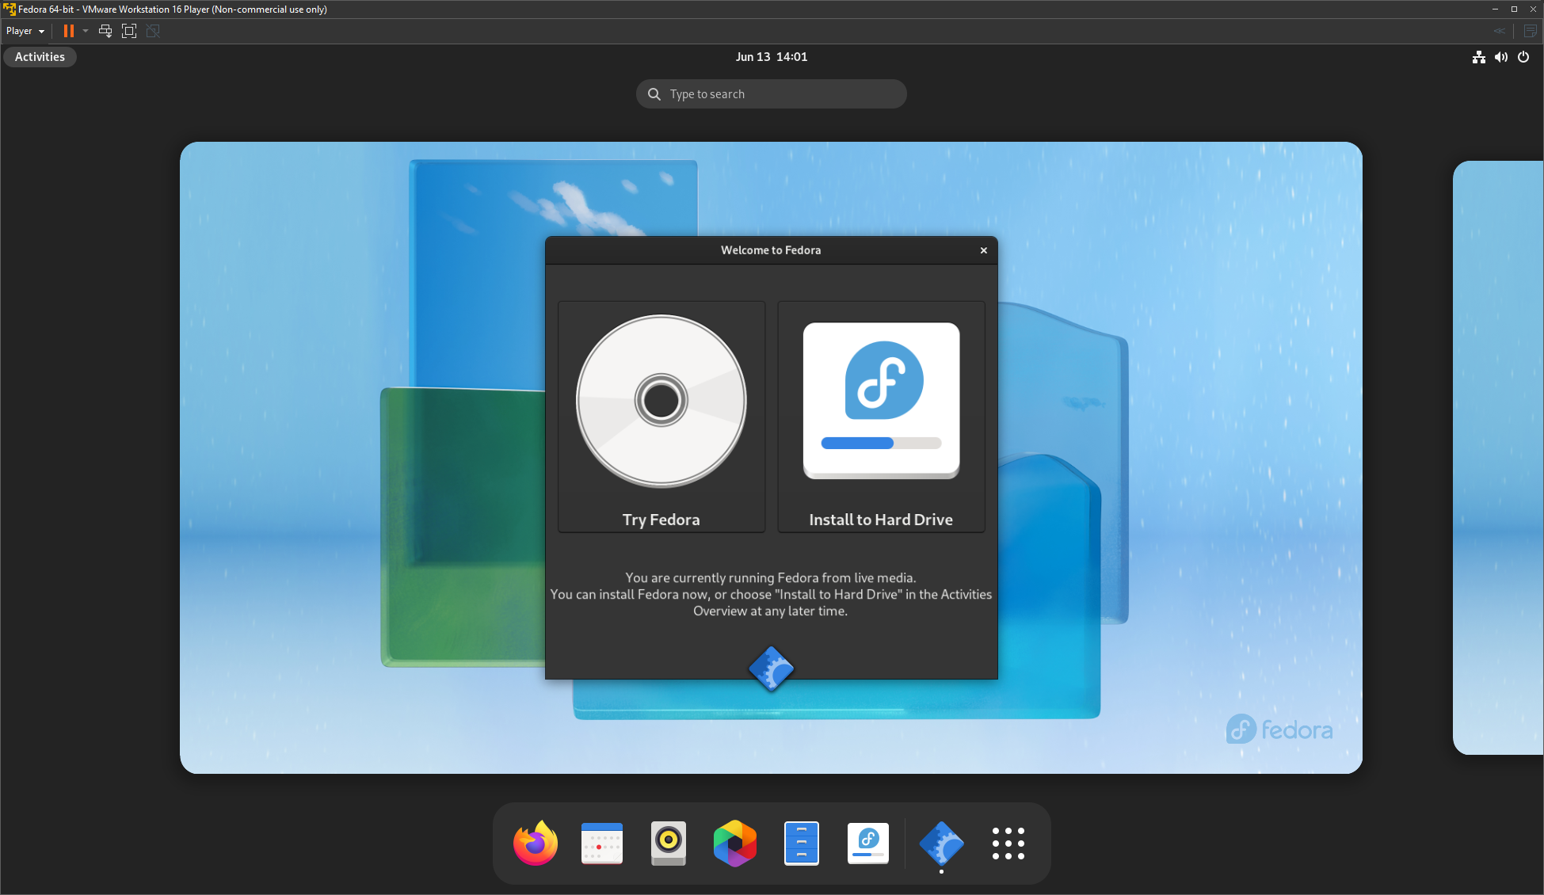
Live CD
Notes:
Something a little different you’ll notice if you’ve ever re-installed windows is that you’re dropped straight into a desktop without being asked to format any drives or even create a user. Windows install media always thinks you want to install windows and nothing else. Linux is a bit more respectful here. When you boot your drive, it’ll let you look around a bit before doing any potentially destructive operations. Then when you’re ready, you can click the “install” icon on the desktop and go through with regular installation.

Slide 37
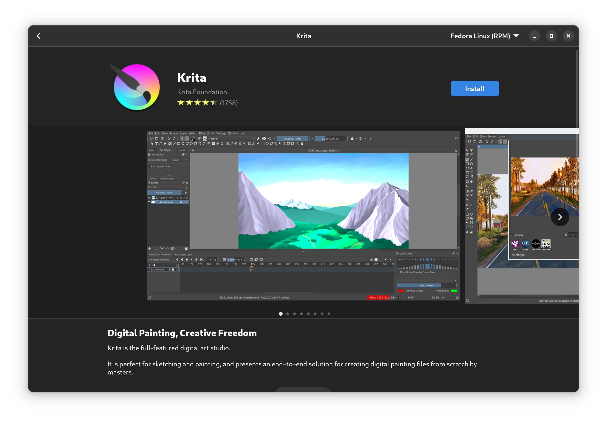
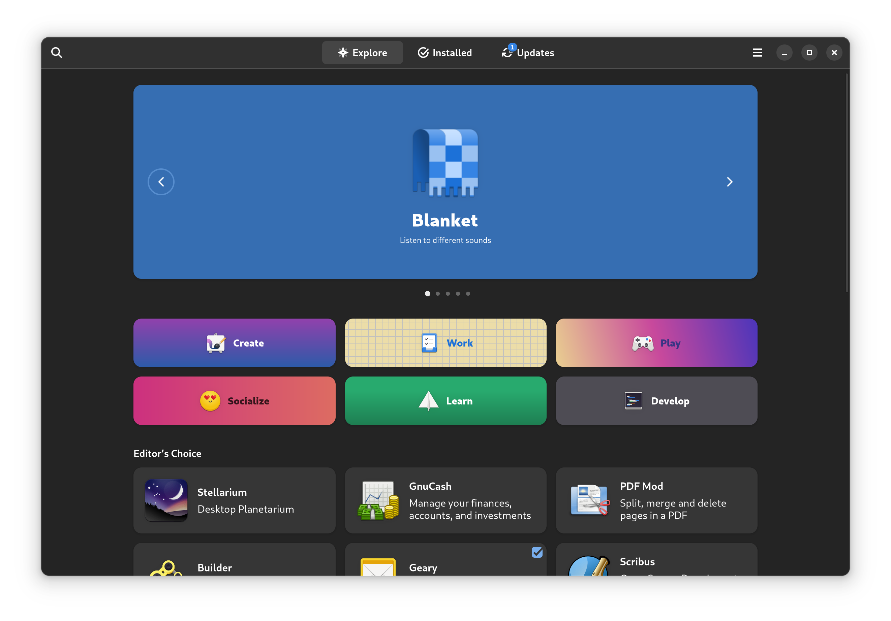
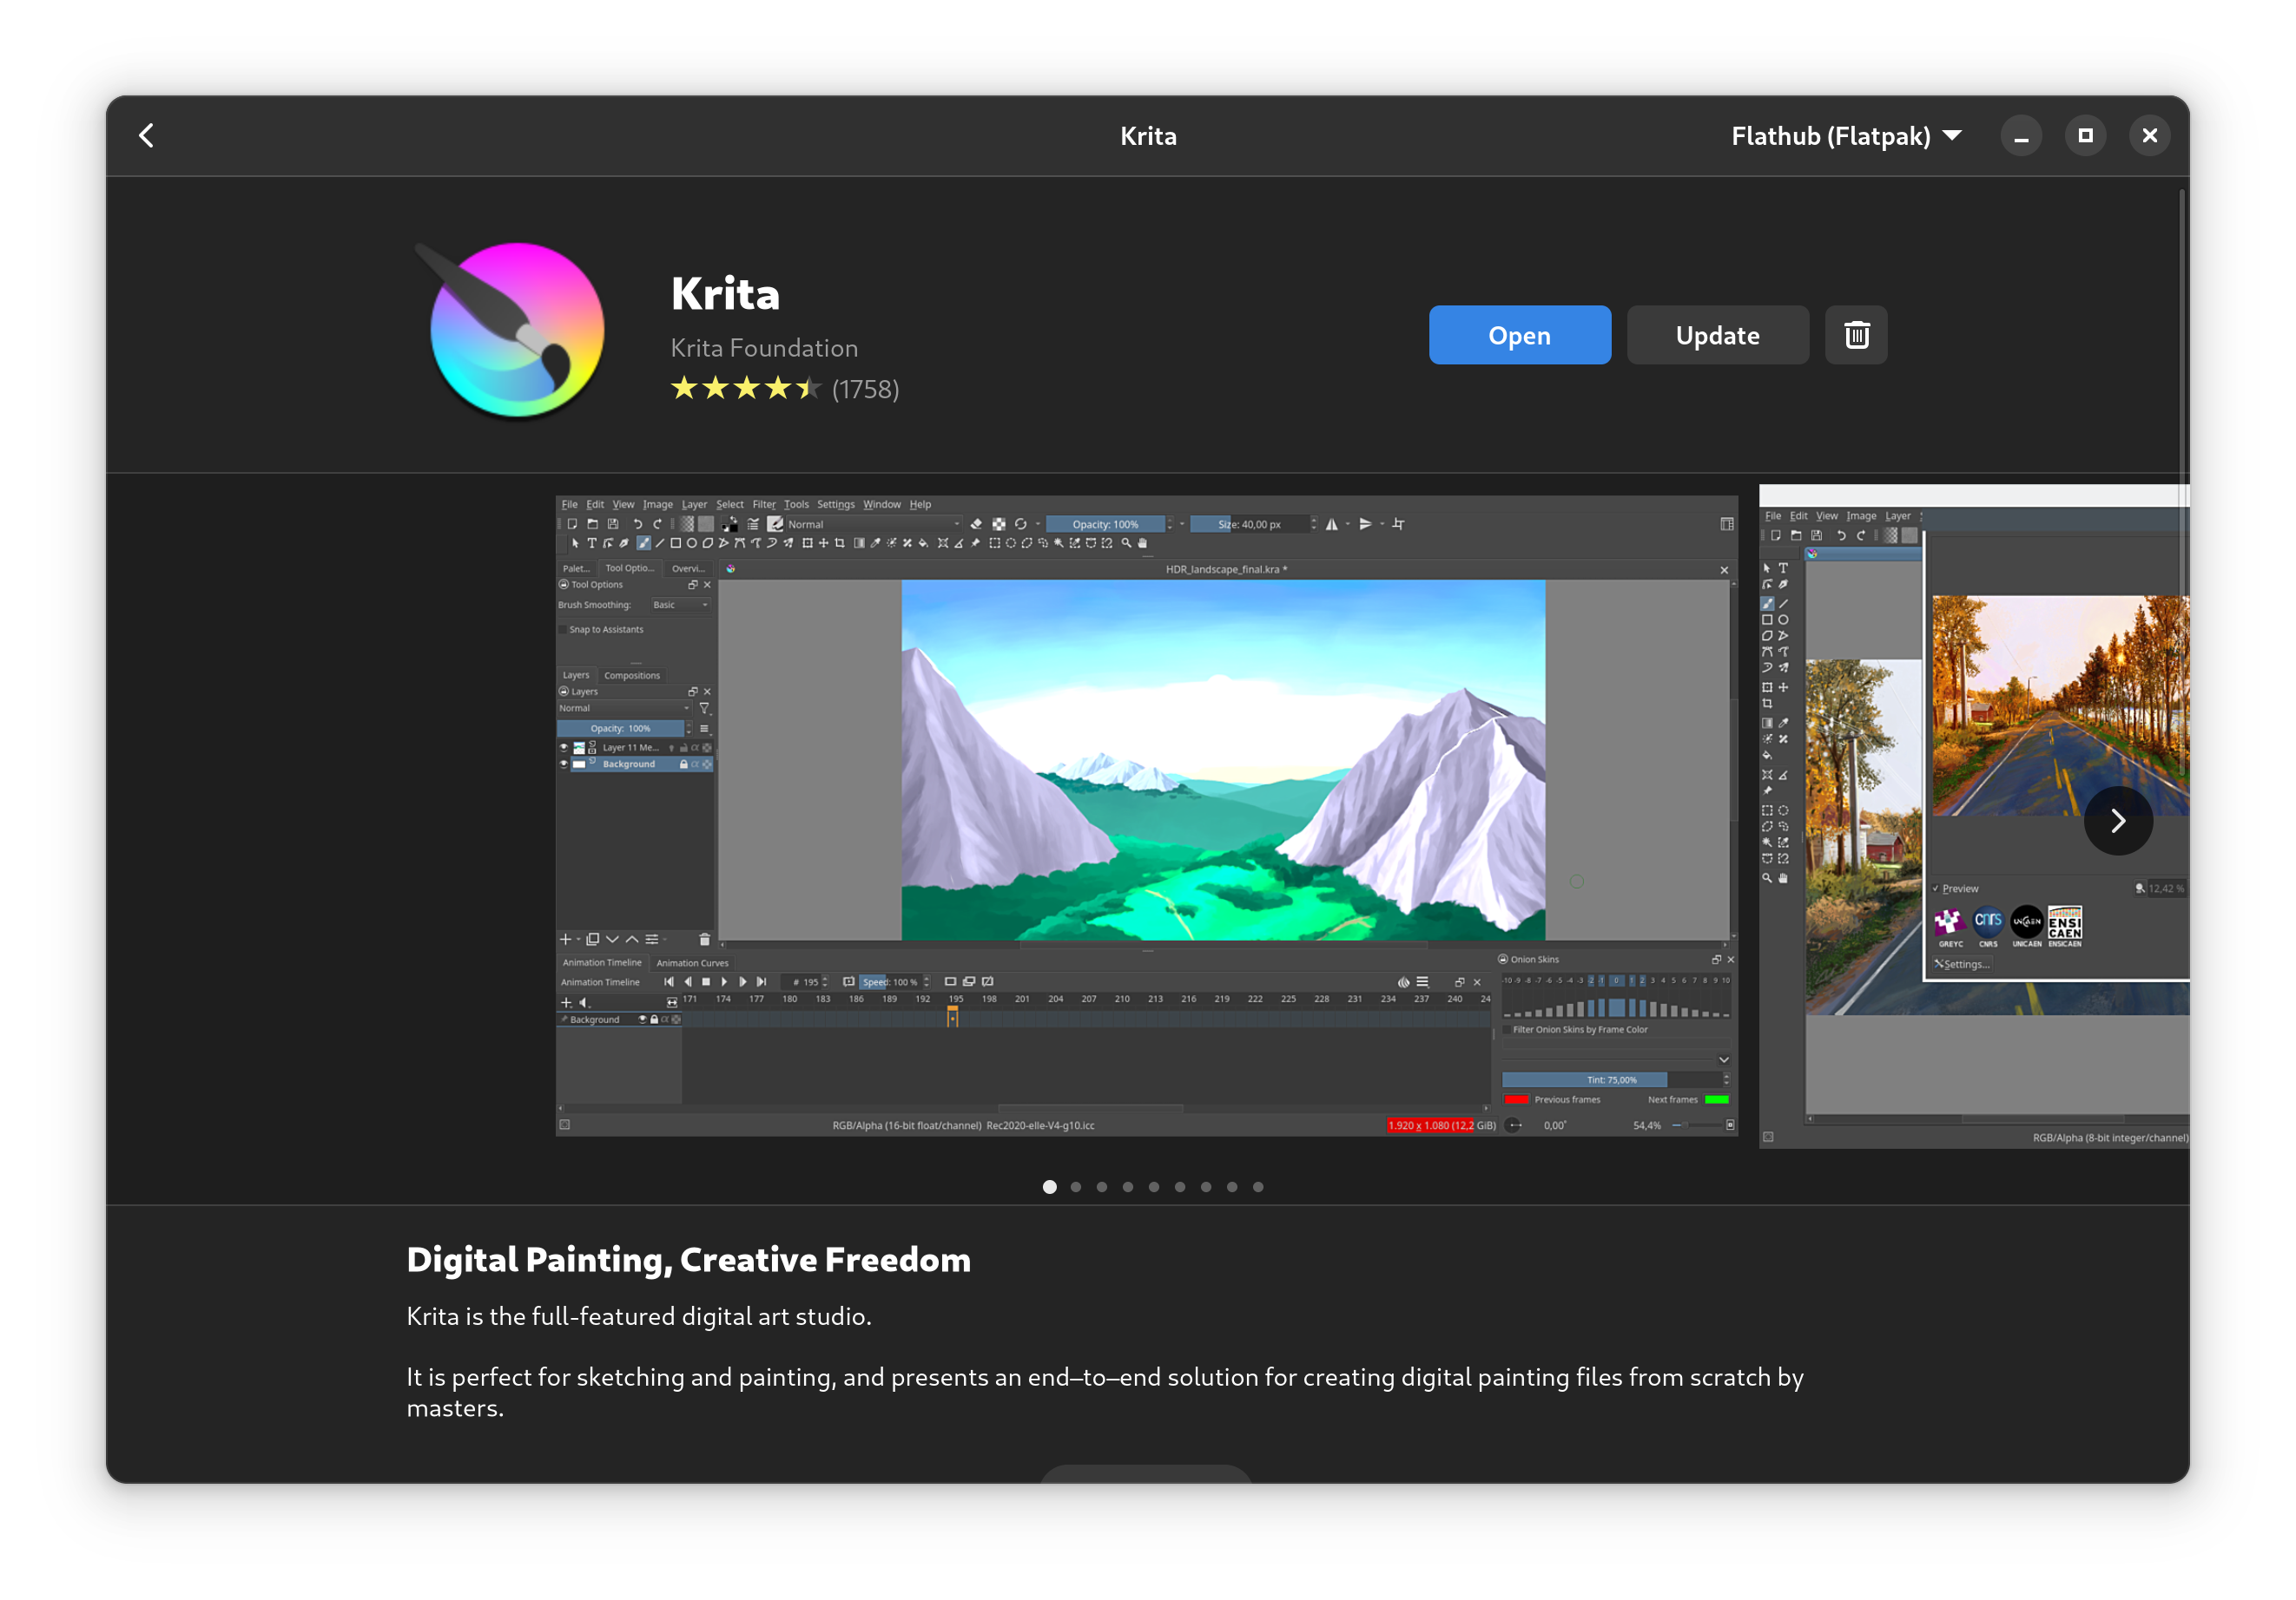
Getting Oriented - Software
Notes:
Okay, now that you’ve got a desktop all set up and ready to go, let’s get acquainted with some of the differences between Linux and whatever you’re used to.
First, nearly all software on Linux is free as in beer. If you’re looking for something you used to use on Windows, there’s likely a free, nearly as good alternative. Instead of office, you can use OnlyOffice. Instead of Photoshop, you can use Krita or the GNU image manipulation program, GIMP. Steam and Discord are already here and work great.
To install things on Fedora, use the Software application. It lets you install and uninstall software at the click of a button. It also handles all your updates, including system updates and firmware updates.

Slide 38
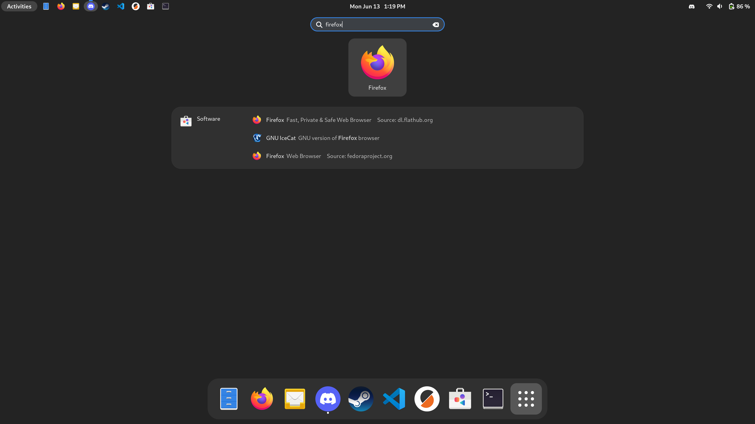
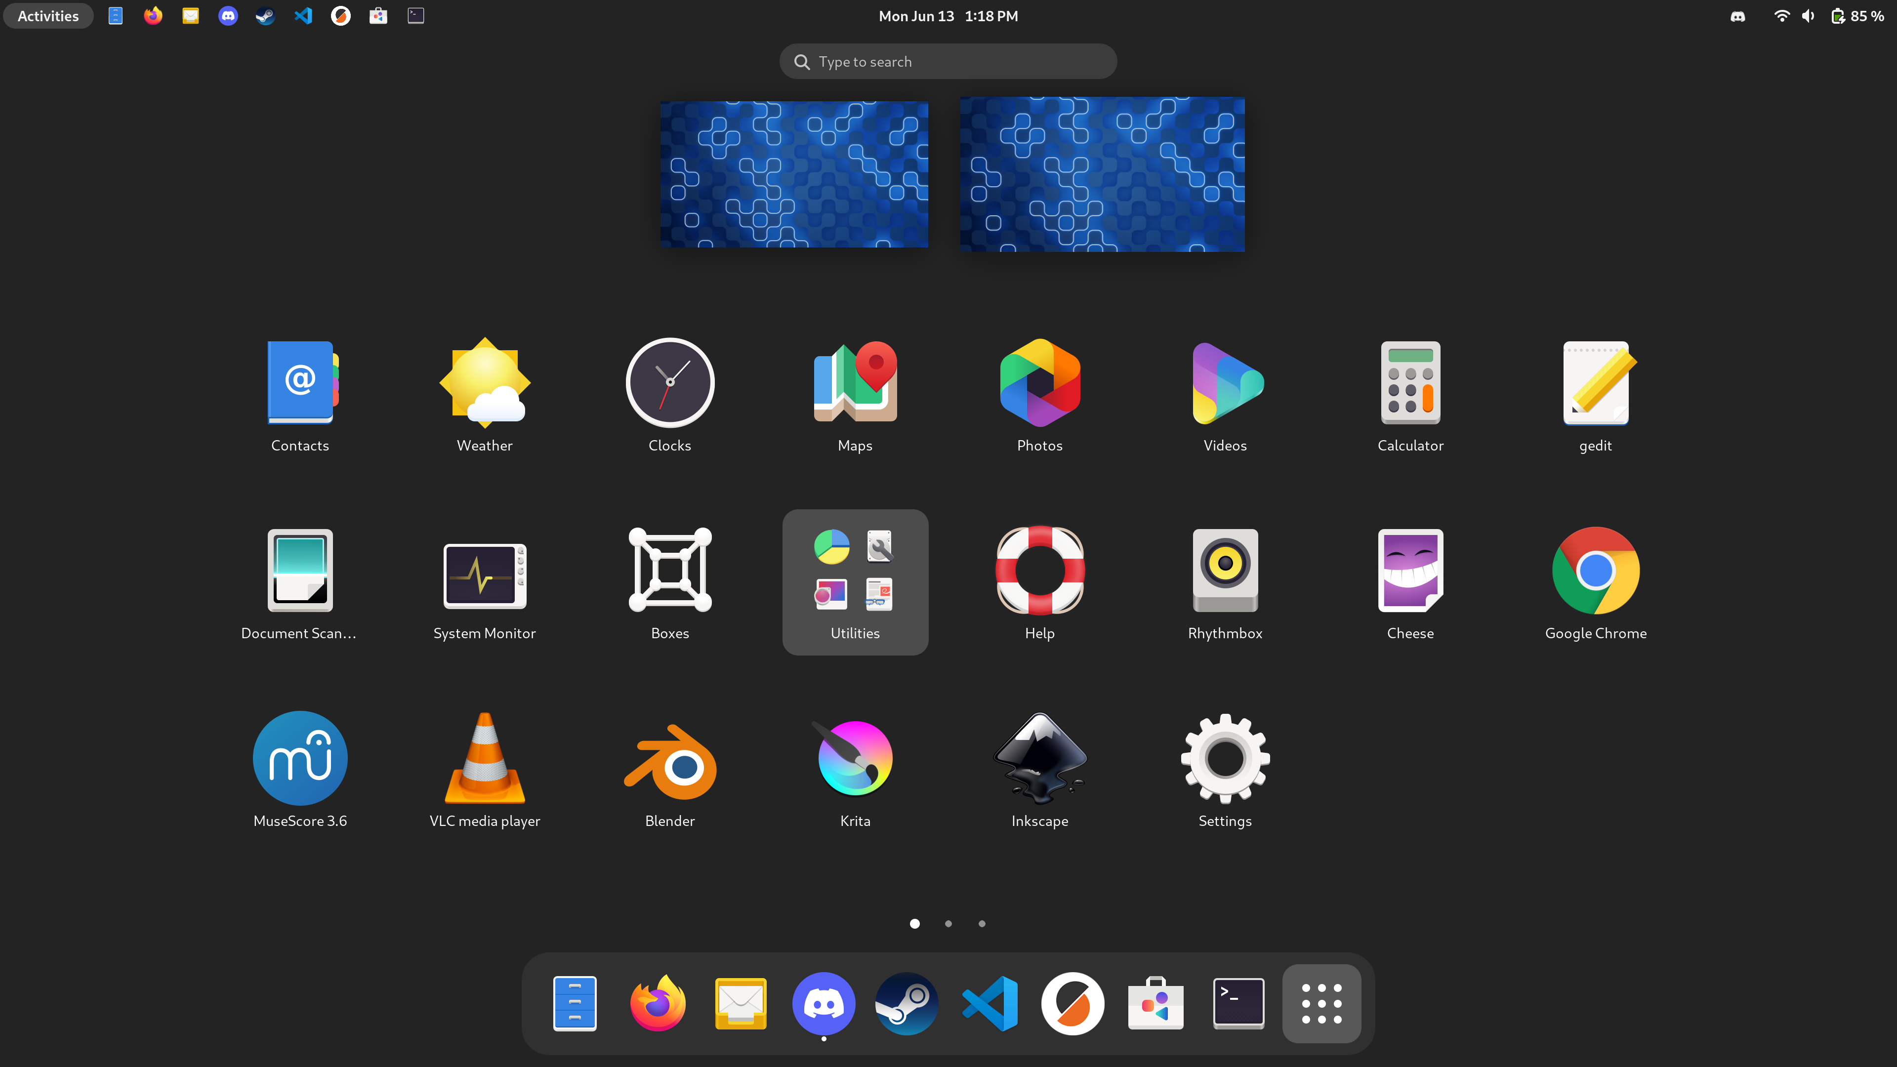
Getting Oriented – Desktop Environment
Notes:
For Fedora with KDE Plasma, you should already feel right at home coming from windows. Plasma has a very similar system of buttons on window bars like close, minimize, and maximize. It also a taskbar and applications menu along the bottom, just like windows.
For Fedora with Gnome, your applications live in a launcher very similar to the launchpad on macOS or the app drawer of android. Just like in windows, you can hit the windows button and start typing to search up an application by name. Just like in all modern OSes, you can swipe three fingers up to find virtual desktops, though these are called workspaces and have superpowers. You can drag an app from the dock to a workspace to launch it there. You can drag windows between workspaces directly, no need to switch to that workspace first. There are even keyboard shortcuts!

Slide 39
Getting Oriented – Folder Structure
/
The root directory
Notes:
If you need to look for files, you’ll need to know a little bit about the UNIX style file system.
Linux, unlike windows, uses forward slashes for its directories. That’s a minor change. A more major change is what those folders are called. Many of the folders in Linux have very short names because Linux, and UNIX before it, had to work using a keyboard and often over a slow remote connection. We’ll talk more about terminals and shells in a while, but they’re why these names are all so short.
The first directory is root, or slash. If you think of your files as being in a collection of folders, this is the outermost folder that holds everything.
/bin contains binaries. Binaries are programs. Since this is the top level, most of the binaries here are for the system and can be used by any user. /sbin is the same, but contains binaries that only super users (administrators) can use

Slide 40
Getting Oriented – Folder Structure
/
/bin
/bin/cd
/bin/ls
Notes:
/bin contains binaries. Binaries are programs. Since this is the top level, most of the binaries here are for the system and can be used by any user. /sbin is the same, but contains binaries that only super users (administrators) can use

Slide 41
Getting Oriented – Folder Structure
/
/bin
/dev
/dev/null
/dev/random
Notes:
/dev contains “device” files, which aren’t actually files at all. UNIX decided early on to just pretend that devices connected to your computer were files that it could read from and write to. /dev/null is basically a trash can you can send things to if you want them destroyed. /dev/random contains infinite random numbers.

Slide 42
Getting Oriented – Folder Structure
/
/bin
/dev
/etc
/etc/passwd
/etc/hosts
Notes:
/etc is all the “et cetera” files. In the early days of UNIX, they didn’t have a good place for everything, so they made this for miscellaneous files. Now it’s mostly used for system configuration files. /etc/passwd contains users’ passwords, /etc/hosts lets you override network settings, etc.

Slide 43
Getting Oriented – Folder Structure
/
/bin
/dev
/etc
/home
/home/caleb
/home/caleb/documents
/home/caleb/catvideos
Notes:
/home is where the heart is. It’s also where your personal files live. This folder is analogous to windows C:\users\caleb folder. Inside it are subfolders for documents, videos, pictures, etc. Unless you’re an administrator, you only get access to your home directory.

Slide 44
Getting Oriented – Folder Structure
/
/bin
/dev
/etc
/home
/usr
/usr/bin
/usr/share
Notes:
/usr is where all the “user level but not specific to one person” stuff lives. /usr/bin contains binaries intended for users. /usr/share contains documentation

Slide 45
Getting Oriented – Folder Structure
/
/bin
/dev
/etc
/home
/usr
/lib
/opt
/var
/tmp
/mnt
/media
Notes:
And now for the lightning round! /lib contains shared libraries. These are similar to DLL files in windows.
/opt contains optional software like you’d get from installing office off of a CD back in the day.
/var contains variable data. This is where most programs store logs, caches, and similar files.
/tmp is temporary files.
/mnt and /media are where removable and permanent drives live.

Slide 46
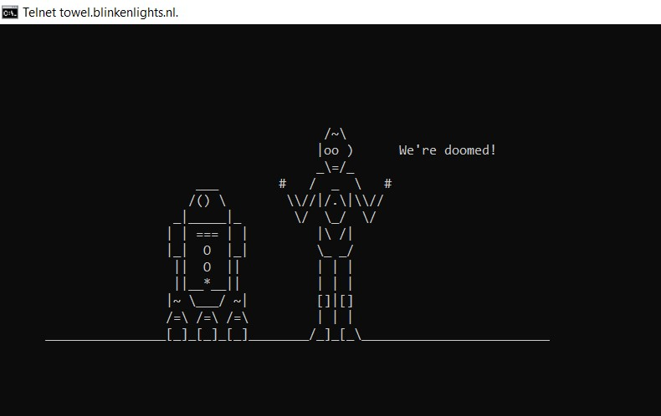
The command line (is not necessary)
> sudo apt-get install –qy yarn
> vim ~/.bashrc
Notes:
Okay, it’s time to address the elephant in the room. If you’ve ever tried to use Linux in the past, you may have been turned off from it by all the command line that you absolutely had to know. Need to install a package? sudo apt-get install –qy somepackage. Need to change a setting? vim ~/.somethingrc. Hope you learned vim before you came here, or you’re never getting out.
Well, I am pleased to report that this is no longer necessary. Modern Linux distributions have graphical interfaces for installing packages and changing settings. You still can use the command line if you’re more comfortable there, but it’s no longer necessary. You may still see guides that mention it, but documentation is always out of date, even for doing things on windows and macintoshes. In fact, let’s install a package and change a setting.

Slide 47
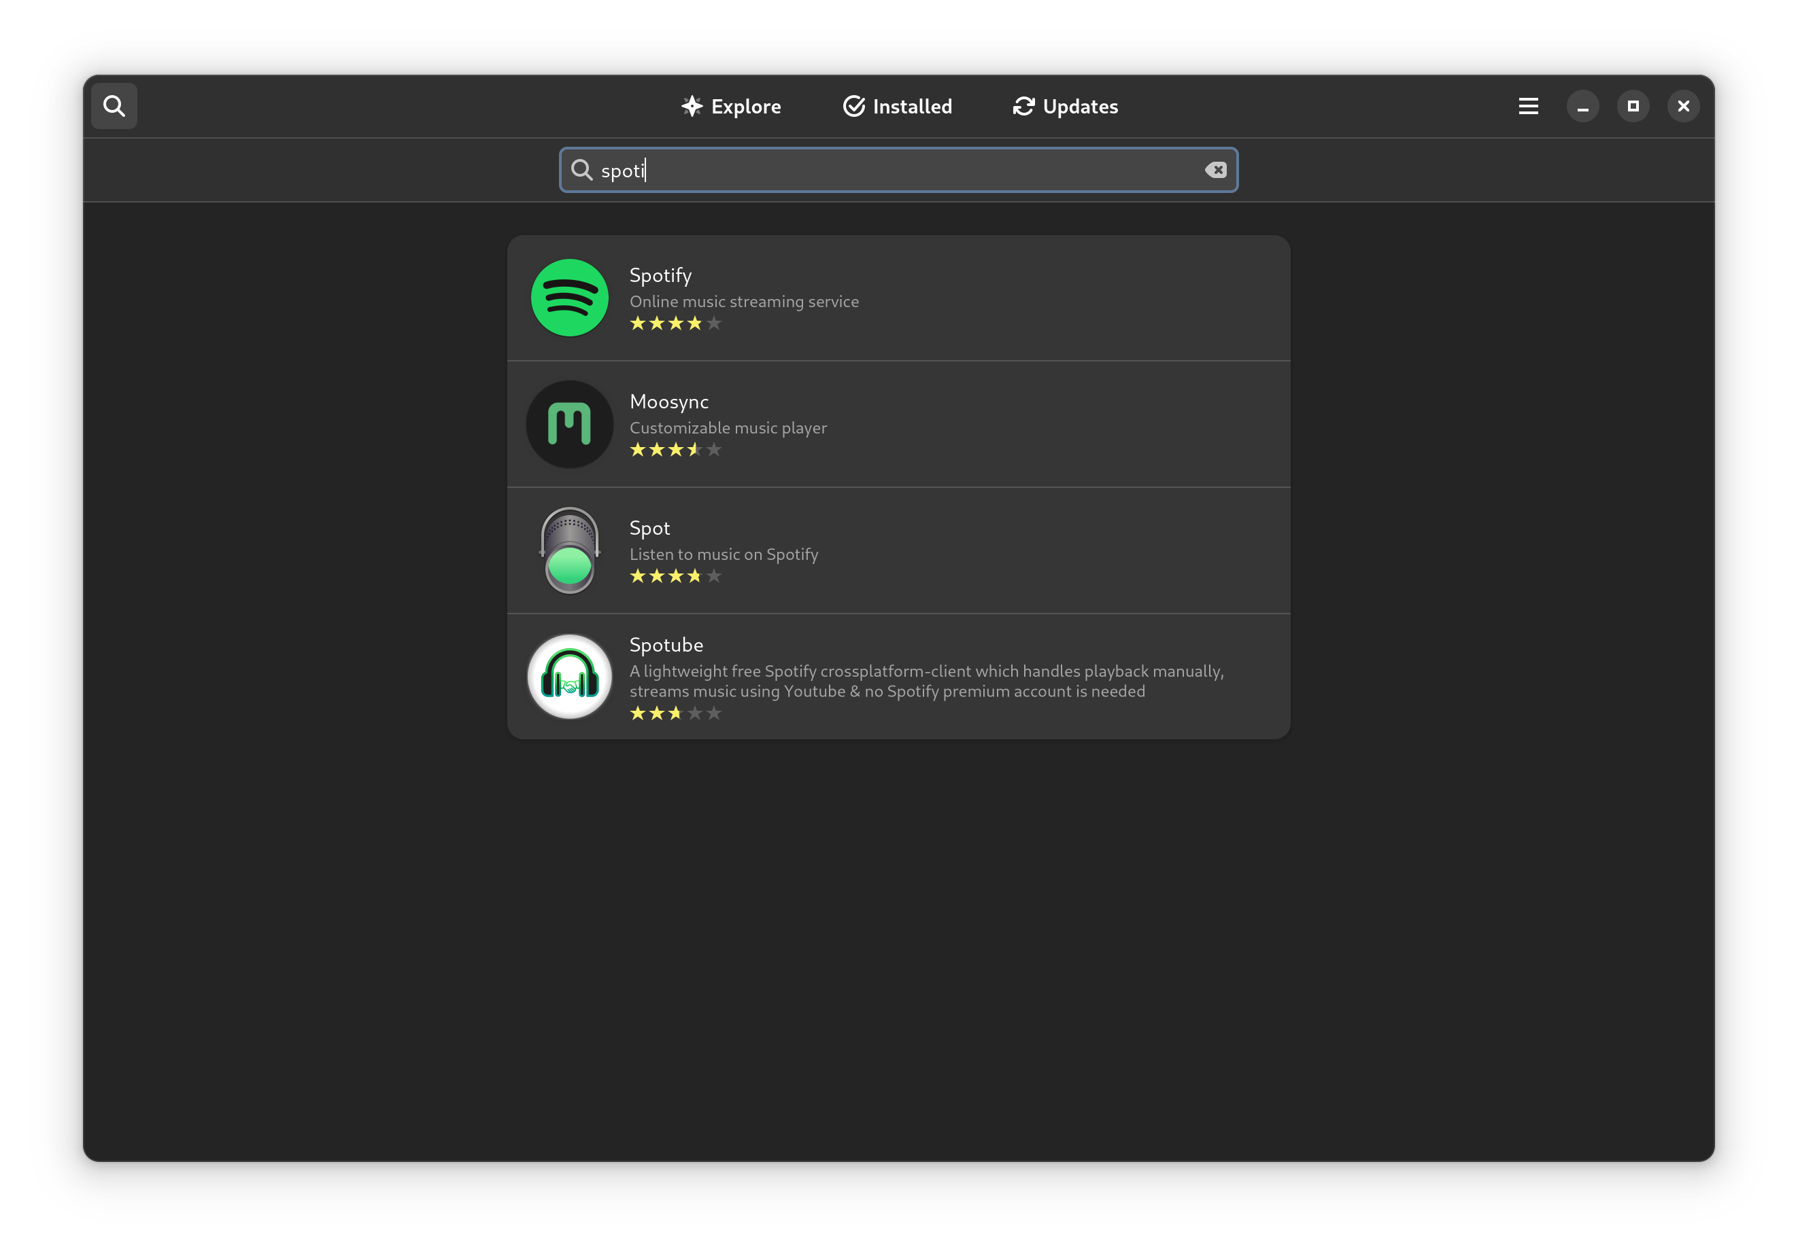
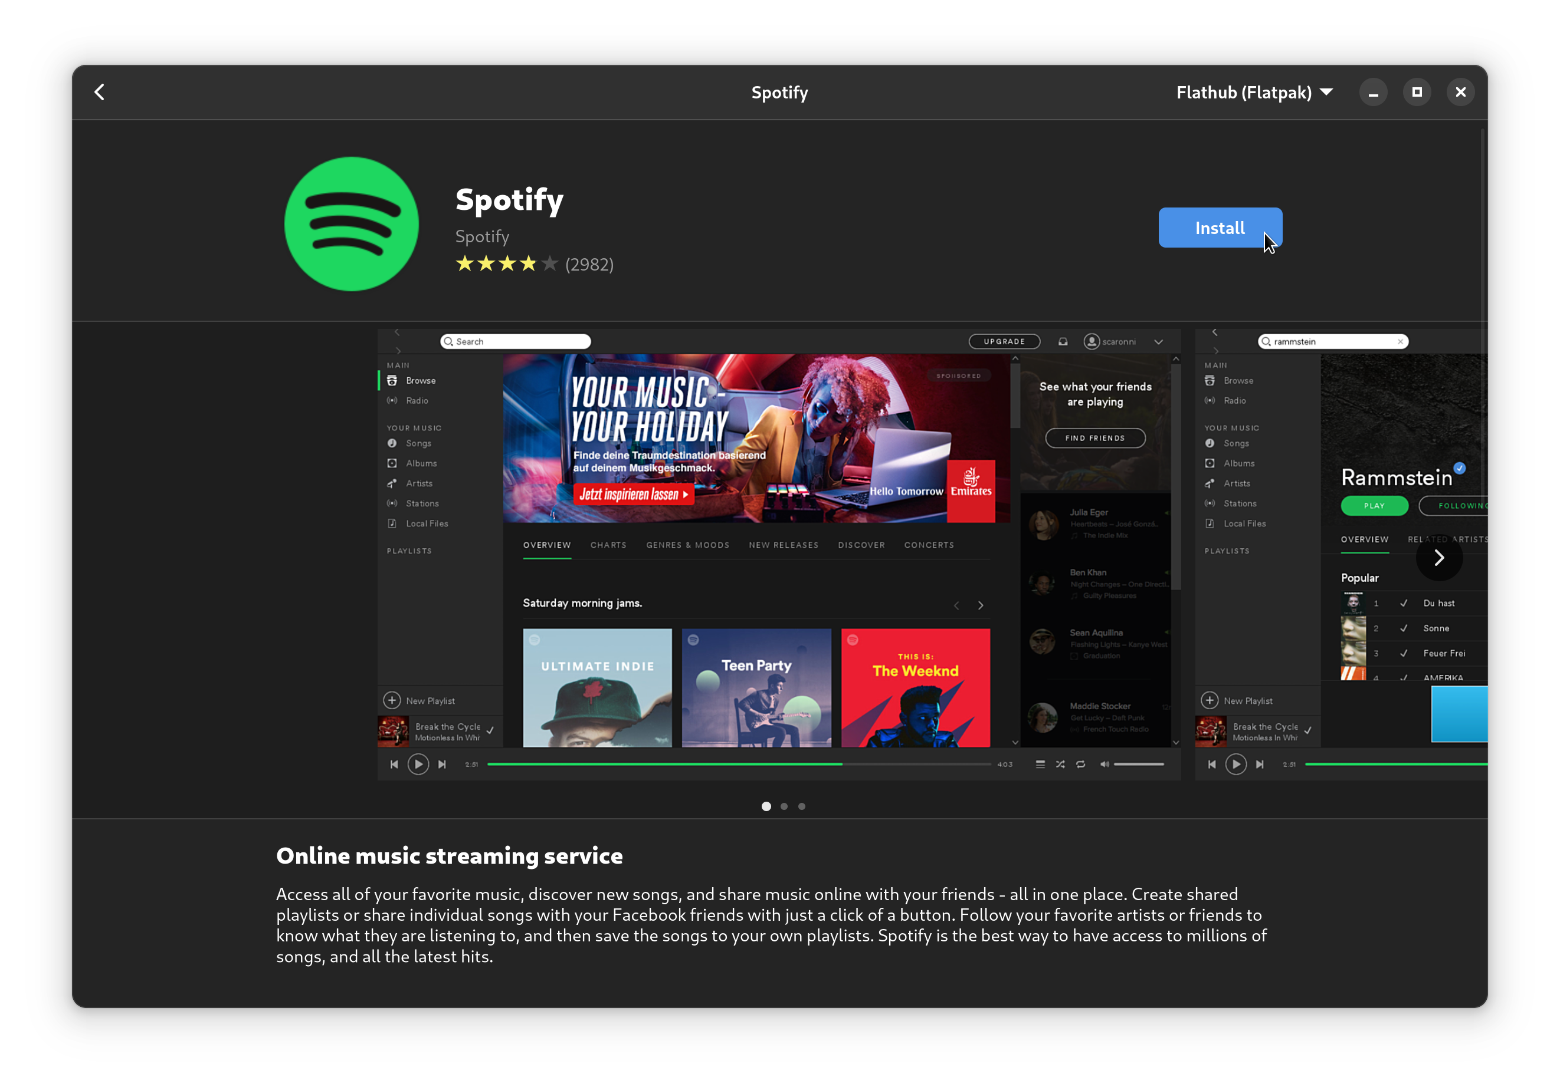
Installing a package
Notes:
First I’m going to open up software. Then I’m going to search for something I want to install. Let’s say Spotify’s Desktop client. Music is important after all. I click search, and type spotify, it shows up, and I click install. When I click install, it asks for my password, and boom. Installed.
More importantly, I didn’t go to google to get whoever paid the most for ad space installing viruses on my computer. I got this software from a trusted source, and installing it was one click. No dodgy websites or proving I’m not a robot or waiting 60 seconds.

Slide 48
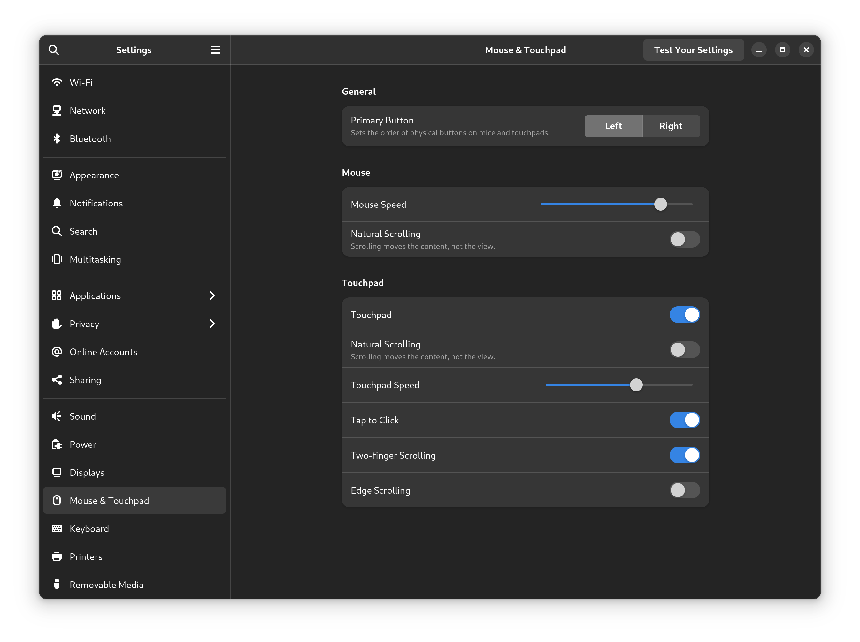
Changing a setting
Notes:
Okay, now let’s change a setting. I think the default mouse pointer speed on every system is way too slow. So, let’s open up settings. Look, here’s a category for mouse and touchpad. And here’s the setting. And let’s turn off this unnatural scrolling while we’re in here. If you’ll permit me a little rant, there is nothing natural about natural scrolling. On a mouse, when you move your finger away from you on the scroll wheel, you go up. When you pull it toward you, you go down. If you were to place your mouse on the screen, up the screen scrolling goes up, down the screen scrolling goes down. Trackpads should work the same way. Touchscreens are the only thing that should work the opposite way. On a touch screen, I’m grabbing the actual document, not the scroll bar. Okay, rant over. Back to the command line.

Slide 49
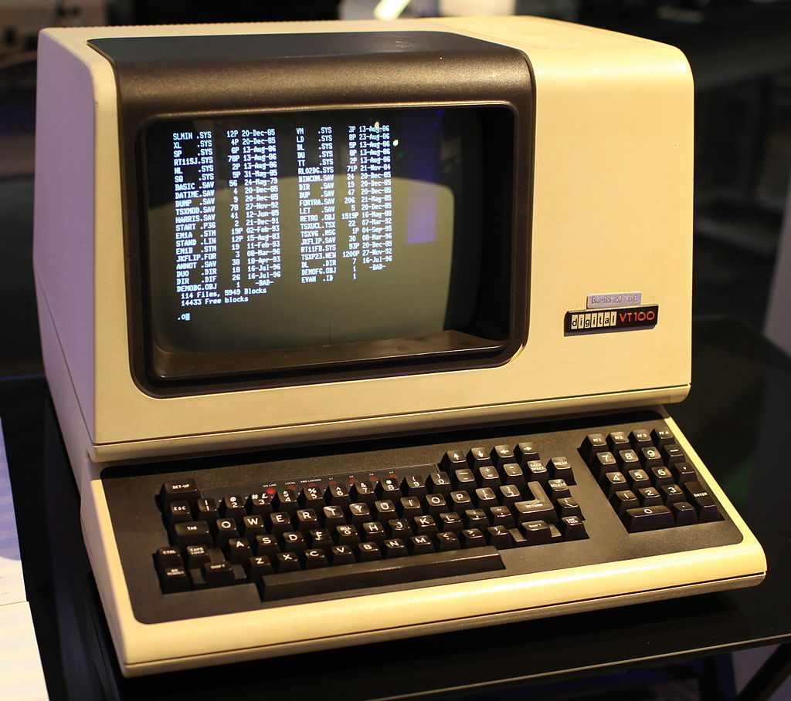
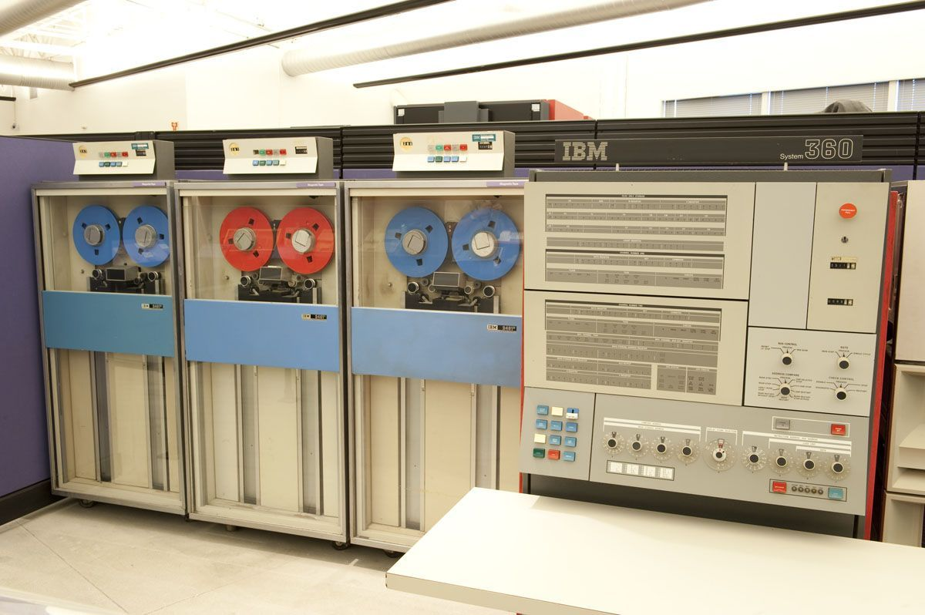
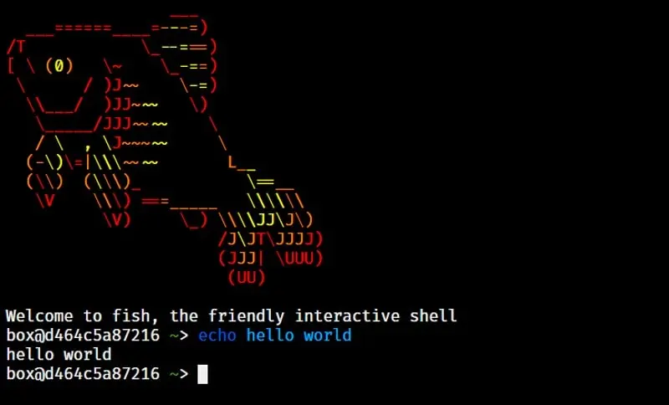
The command line (is not scary)
A terminal
powers
which displays
A mainframe
A shell
Notes:
The command line on Linux is kind of like driving a manual car. It comes from the past, it’s very powerful, but you have to do everything. Back in the early days of computing, computers were too expensive for everyone to get their own. Instead, computers were split into a big computing part called a mainframe, and a little screen that remotely connected to it called a terminal. The software that ran on the mainframe and displayed a command prompt to the screen was called a shell. It was called a shell because it was the outermost layer of the operating system, the part designed to interact with users.

Slide 50
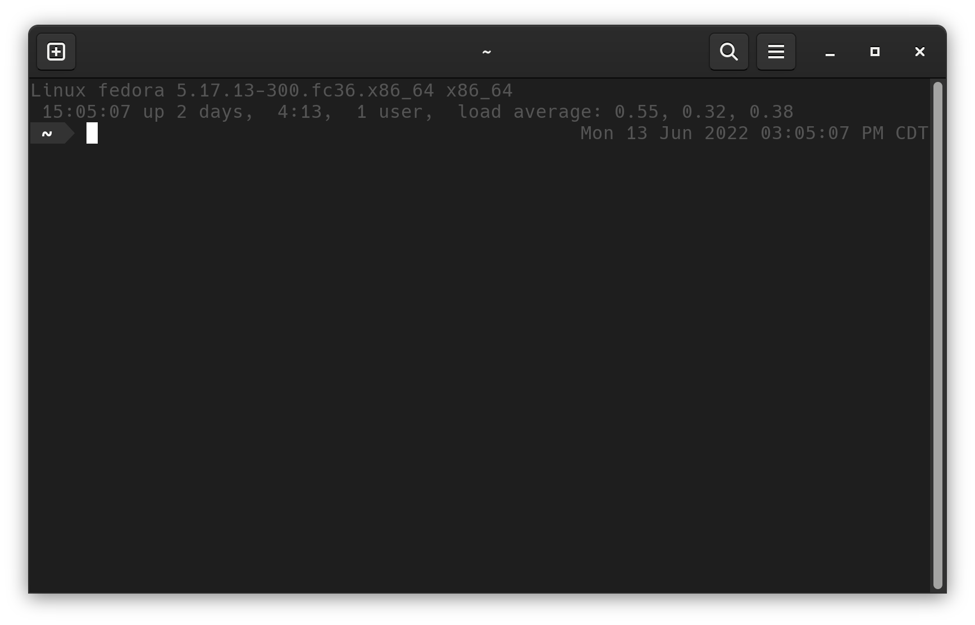
The command line (is not scary)
A terminal emulator
Notes:
Today we don’t use mainframes very often because hardware is cheap. You can literally buy a raspberry pi for $10, or a raspberry pi built into a keyboard for $100. That’s less than a used android phone, and you all have phones, right?!? Since hardware is so cheap, you don’t need to connect to a university’s single giant computer to do your computing anymore. You can do it on your phone or laptop. But the words shell and terminal stuck around. Today a terminal emulator is a program that hosts a shell. And today a shell is a program that reads user input and does stuff with it. Since it takes in commands line by line, we call it a command line interface.

Slide 51
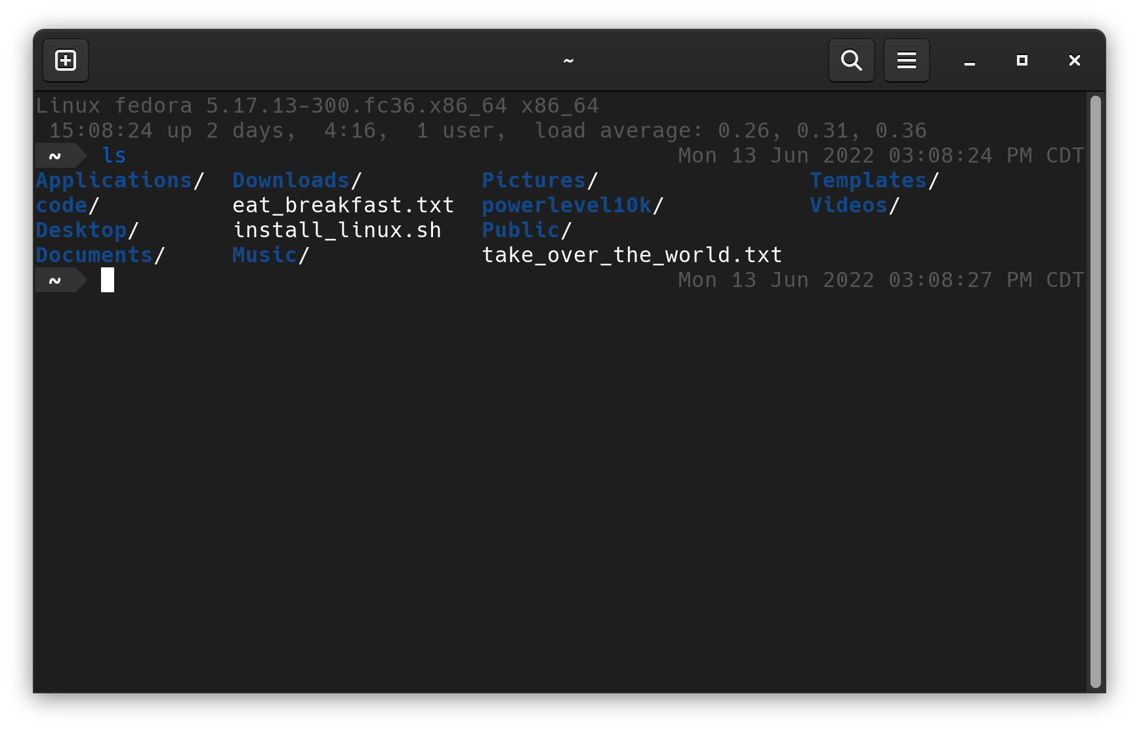
The Command Line Interface
Notes:
If you open up a terminal, any terminal on any computer, you’re going to be faced with a prompt. It’s asking you to type a command and hit enter. If you type “help” and hit enter, you’ll get help. If you type “exit” and hit enter, you’ll quit the shell and close the terminal. Everything after this will be Linux specific, both because the windows shells suck, and because you can get a Linux shell called Bash on windows pretty easily these days.
If you type LS, you’ll get a listing of files and directories in your current directory.
If you want to change directories, you use CD and pass it a directory name as an argument. So cd /home/caleb goes to my home directory. I’ll note that the first word you type is the name of the command and any words after it are called arguments. Shells today are very powerful, both because there are a lot of commands to choose from and because you can send the output of one command as the input to the next one. So for example, if you want to copy the output of LS to the clipboard, you could pipe your LS command to xclip.
You can also redirect output into a file with a greater than symbol. This is useful for example if you’re wanting to download something from the internet using the command line. curl example.org > output.txt

Slide 52
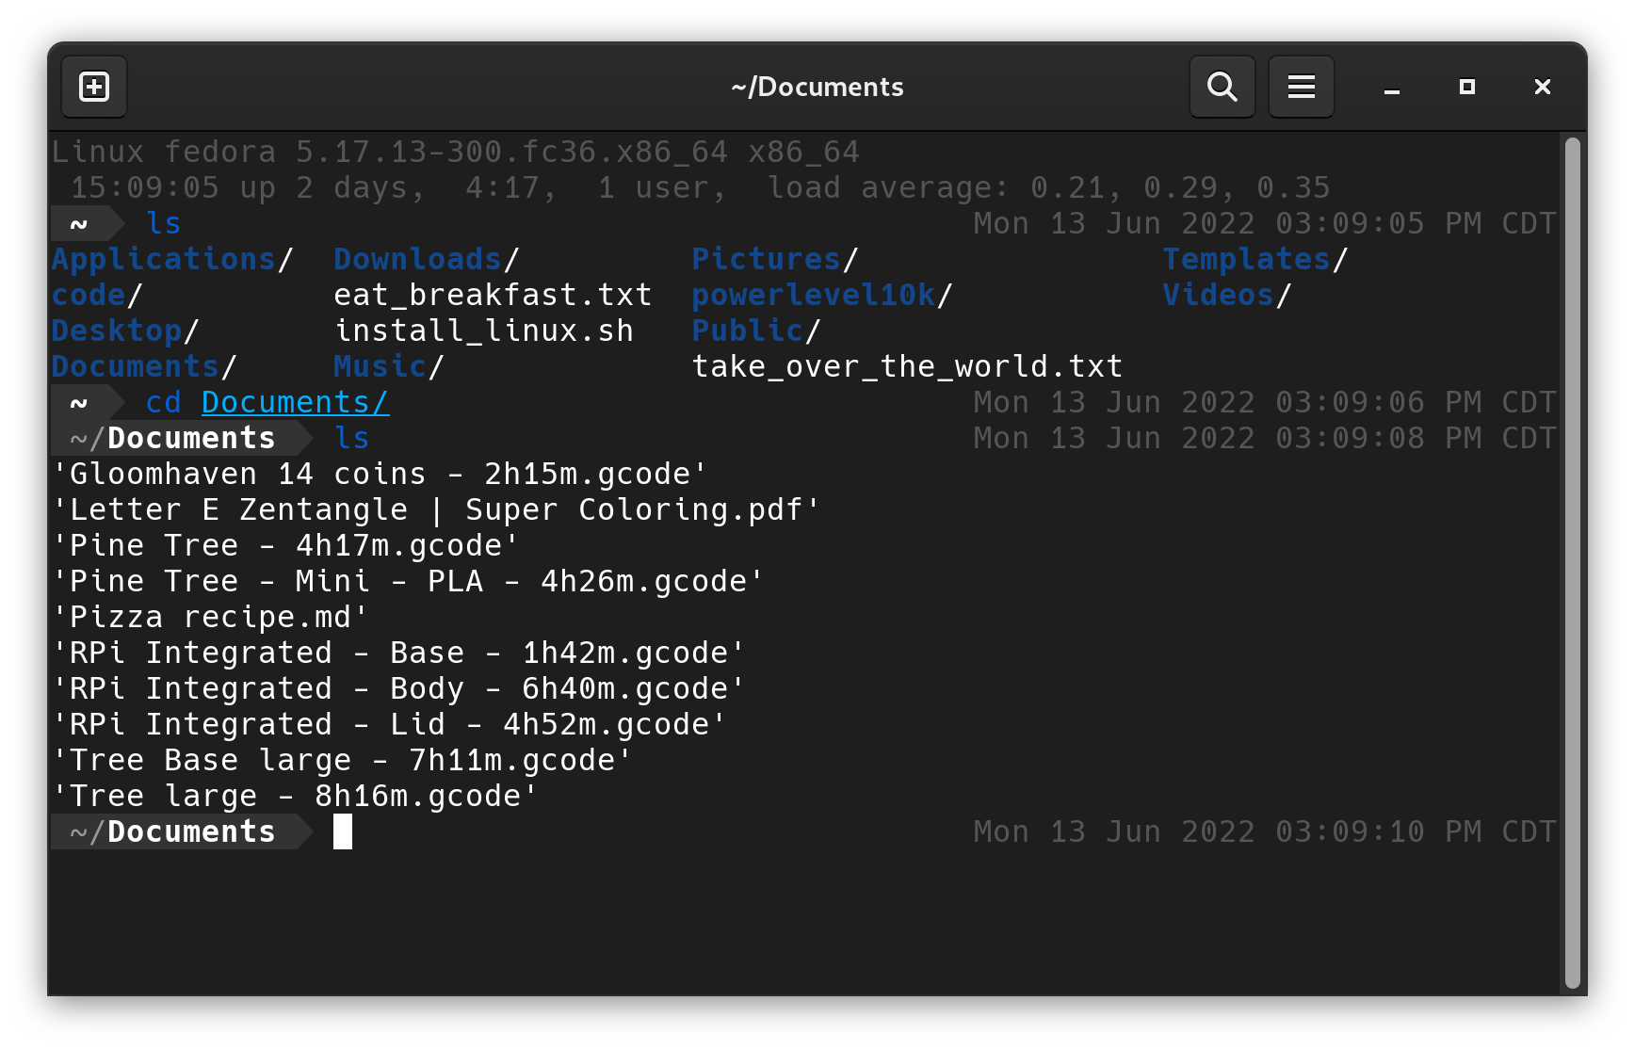
The Command Line Interface
Notes:
If you want to change directories, you use CD and pass it a directory name as an argument. So cd Documents goes to my documents directory.

Slide 53
The Command Line Interface
Command
Arguments
Notes:
I’ll note that the first word you type is the name of the command and any words after it are called arguments. Shells today are very powerful, both because there are a lot of commands to choose from and because you can send the output of one command as the input to the next one.

Slide 54

The Command Line Interface
Notes:
So for example, if you want to copy the output of LS to a cloud pasteboard, you could pipe your LS command to fpaste, fedora’s pasteboard.
You can also redirect output into a file with a greater than symbol. This is useful for example if you’re wanting to download something from the internet using the command line. curl example.org > output.txt

Slide 55
Summary
Notes:
That was a lot of information!
Today we talked about my journey with Linux and why it’s important to me and important in general.
We talked about what Linux is and how it came to be.
And we talked about how you can use Linux yourself and get acquainted with it, including basic tasks like installing software and complex ones like navigating the command line.

Slide 56

Thank You!
https://github.com/calebmeyer/linux-slides
Install Linux instead of Windows 11
https://getfedora.org/
https://www.balena.io/etcher/
Fonts Used: Ubuntu Mono
Ubuntu
Accent Colors Used:
Ubuntu Orange #E95420 Ubuntu Purple #772953
Fedora Light Blue #3C6EB4
Fedora Dark Blue #294172
Notes:
And with that, my talk is finished. We went breadth first and didn’t have time to dive super deep into any of these topics, which is why I’d like to leave you with some suggestions of where to go next.
All my slides will be available on my public github at that first link.
The second link is the video I promised that goes through installing Linux step by step.
The last two links and a flash drive are what you need to get started.

